Slide 1
Azure Maps & Friends IoT Central
Johannes Kebeck 06/19/2022

Slide 2
Step-by-Step
Create IoT Central Application
Add Device(s)
Create Azure Web PubSub
Create & Run Azure Functions Locally
Modify Notification Function
Create Azure Maps Account
Modify Web Page in Azure Function
Deploy Function App to Azure
Export from IoT Central to Webhook
Simulating Movement (Data Capture)
Simulating Movement (Data Replay)
Export from IoT Central to Storage
Process History
Create your own Tile Layer
Create your own Image Overlay
Add the Website to IoT Central
Visualize the Data with Power BI

Slide 3
Prerequisites
Azure Subscription
Azure IoT Central Account
Visual Studio Code with extension(s) - Azure Functions
Node.js
Azure Function Core Tools
Azure CLI
Postman
Azure Storage Explorer
Optional to develop apps for data capturing and replaying
Visual Studio Community Edition
An IDE to develop for your mobile device (here: Android Studio)
QGIS

Slide 4
High-Level Architecture

Slide 5

Azure Maps & IoT Central Create IoT Central App

Slide 6
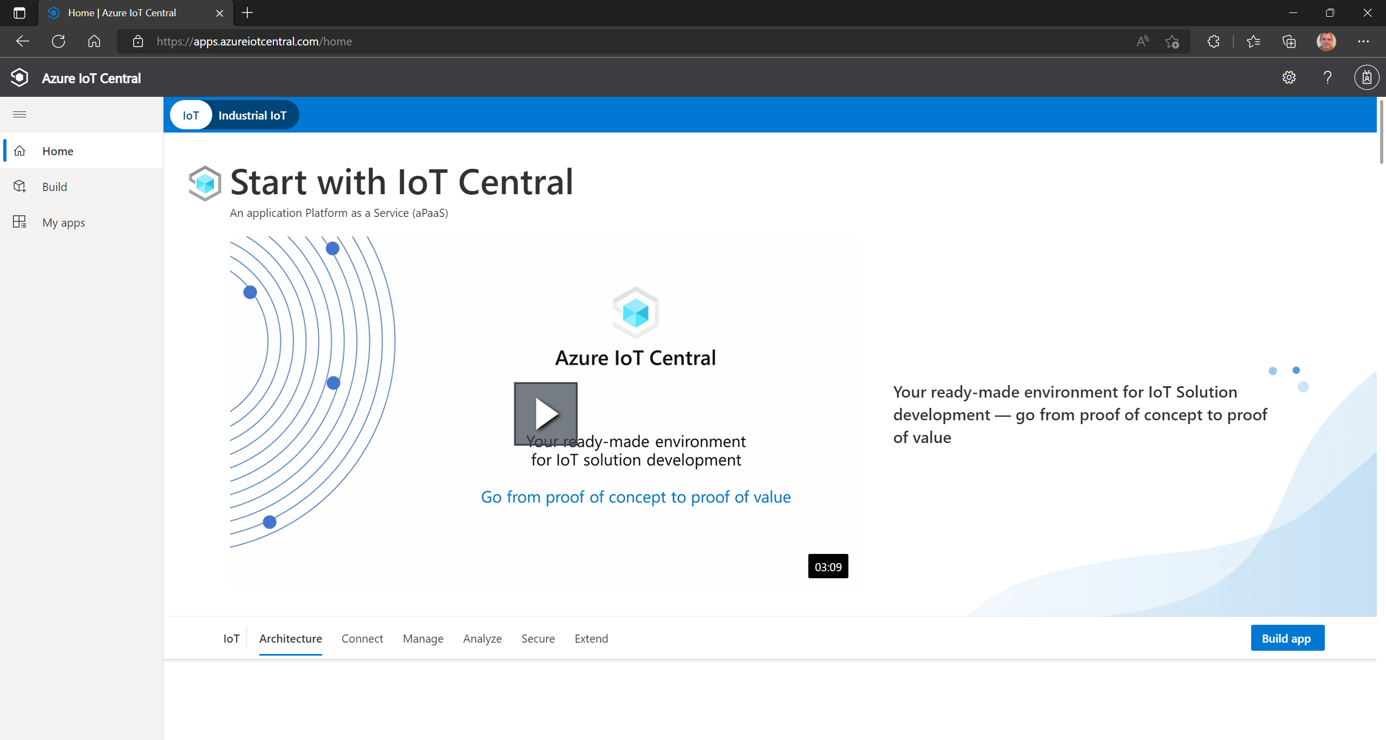
Azure Maps - A Platform of Location-Based Services
Navigate to the IoT Central Homepage and log in with your work account.
Click on [Build app].

Slide 7
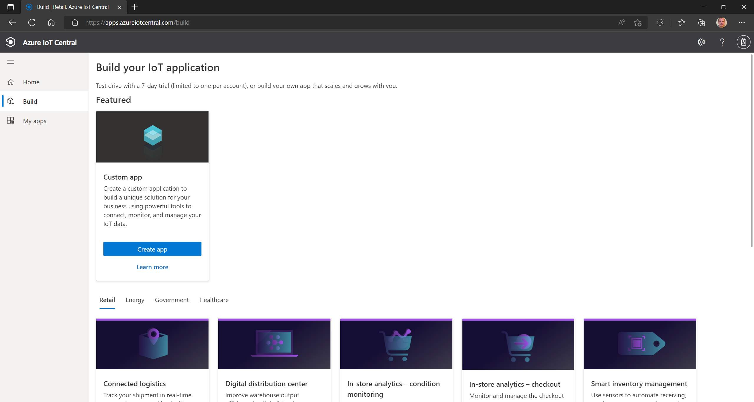
Pick the [Custom app] template and click on [Create app].

Slide 8
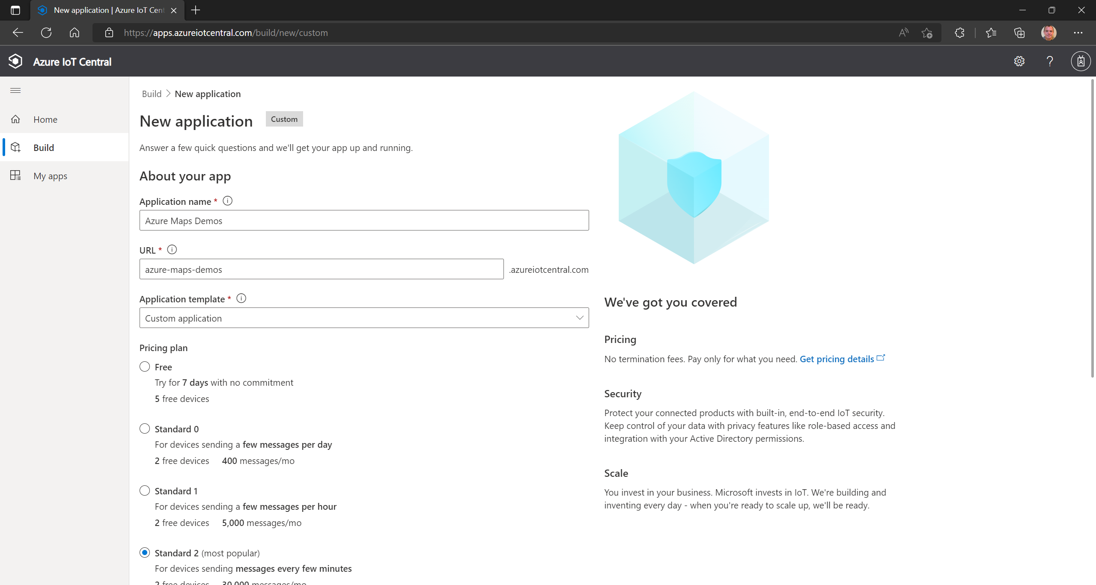
Give the app a name.
Pick a pricing plan (here: Standard 2). You can find more about Azure IoT Central pricing here.
Scroll down…

Slide 9
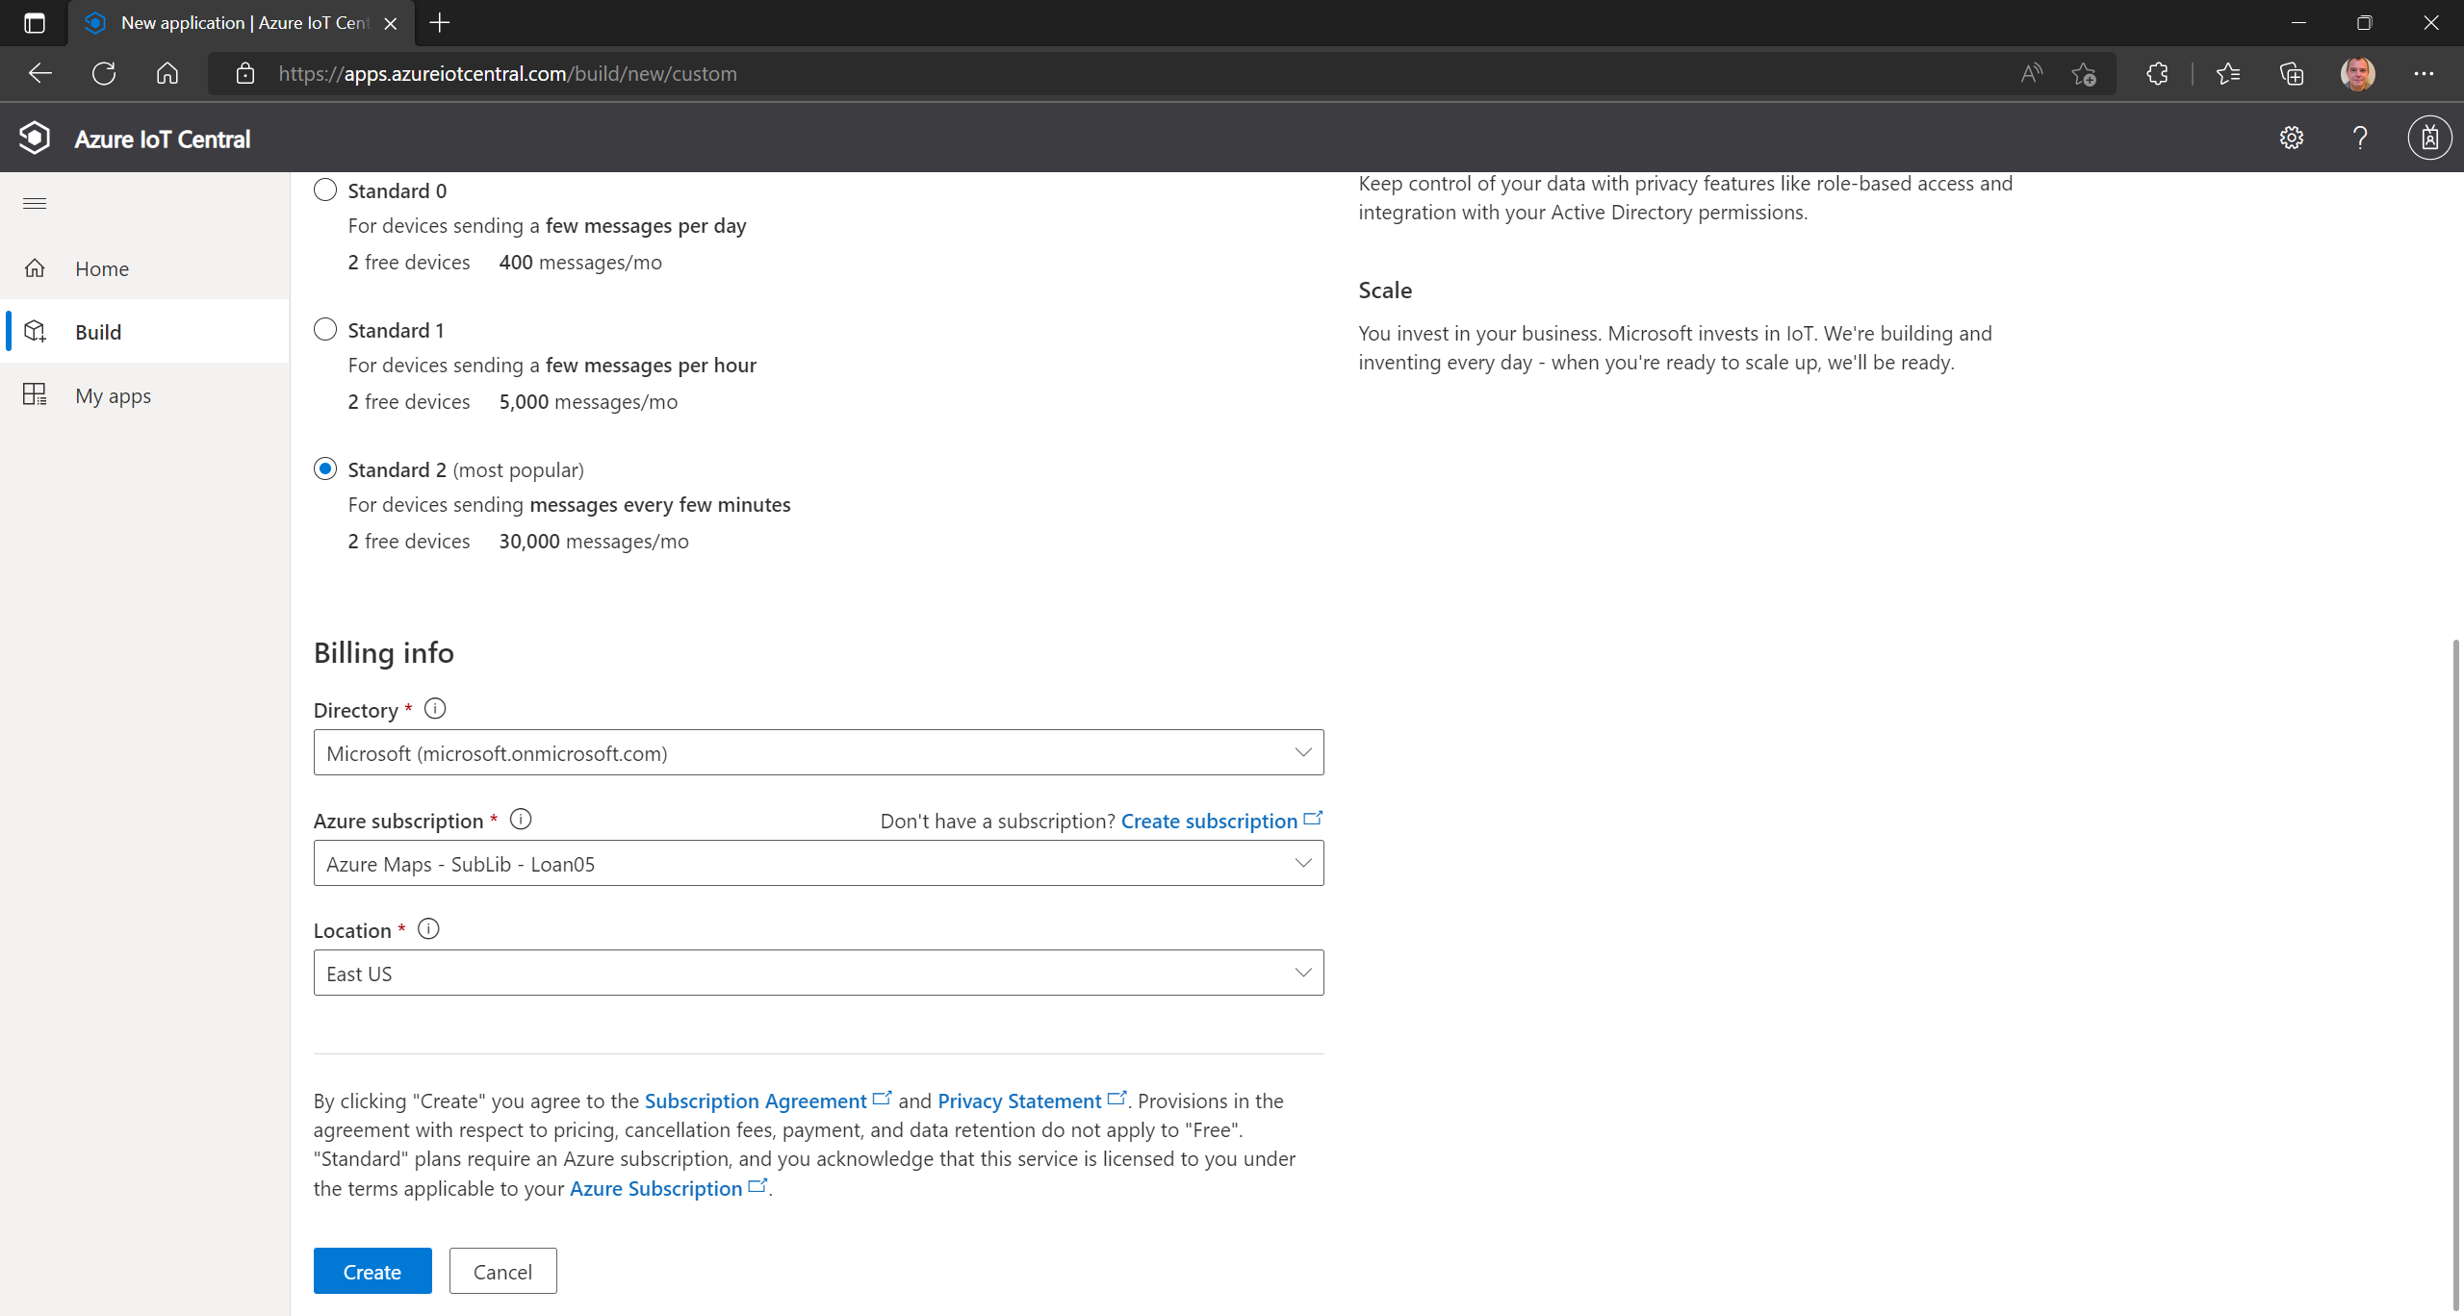
…and pick an Azure Active Directory, a Subscription and a Location to deploy to.
Click on [Create]

Slide 10
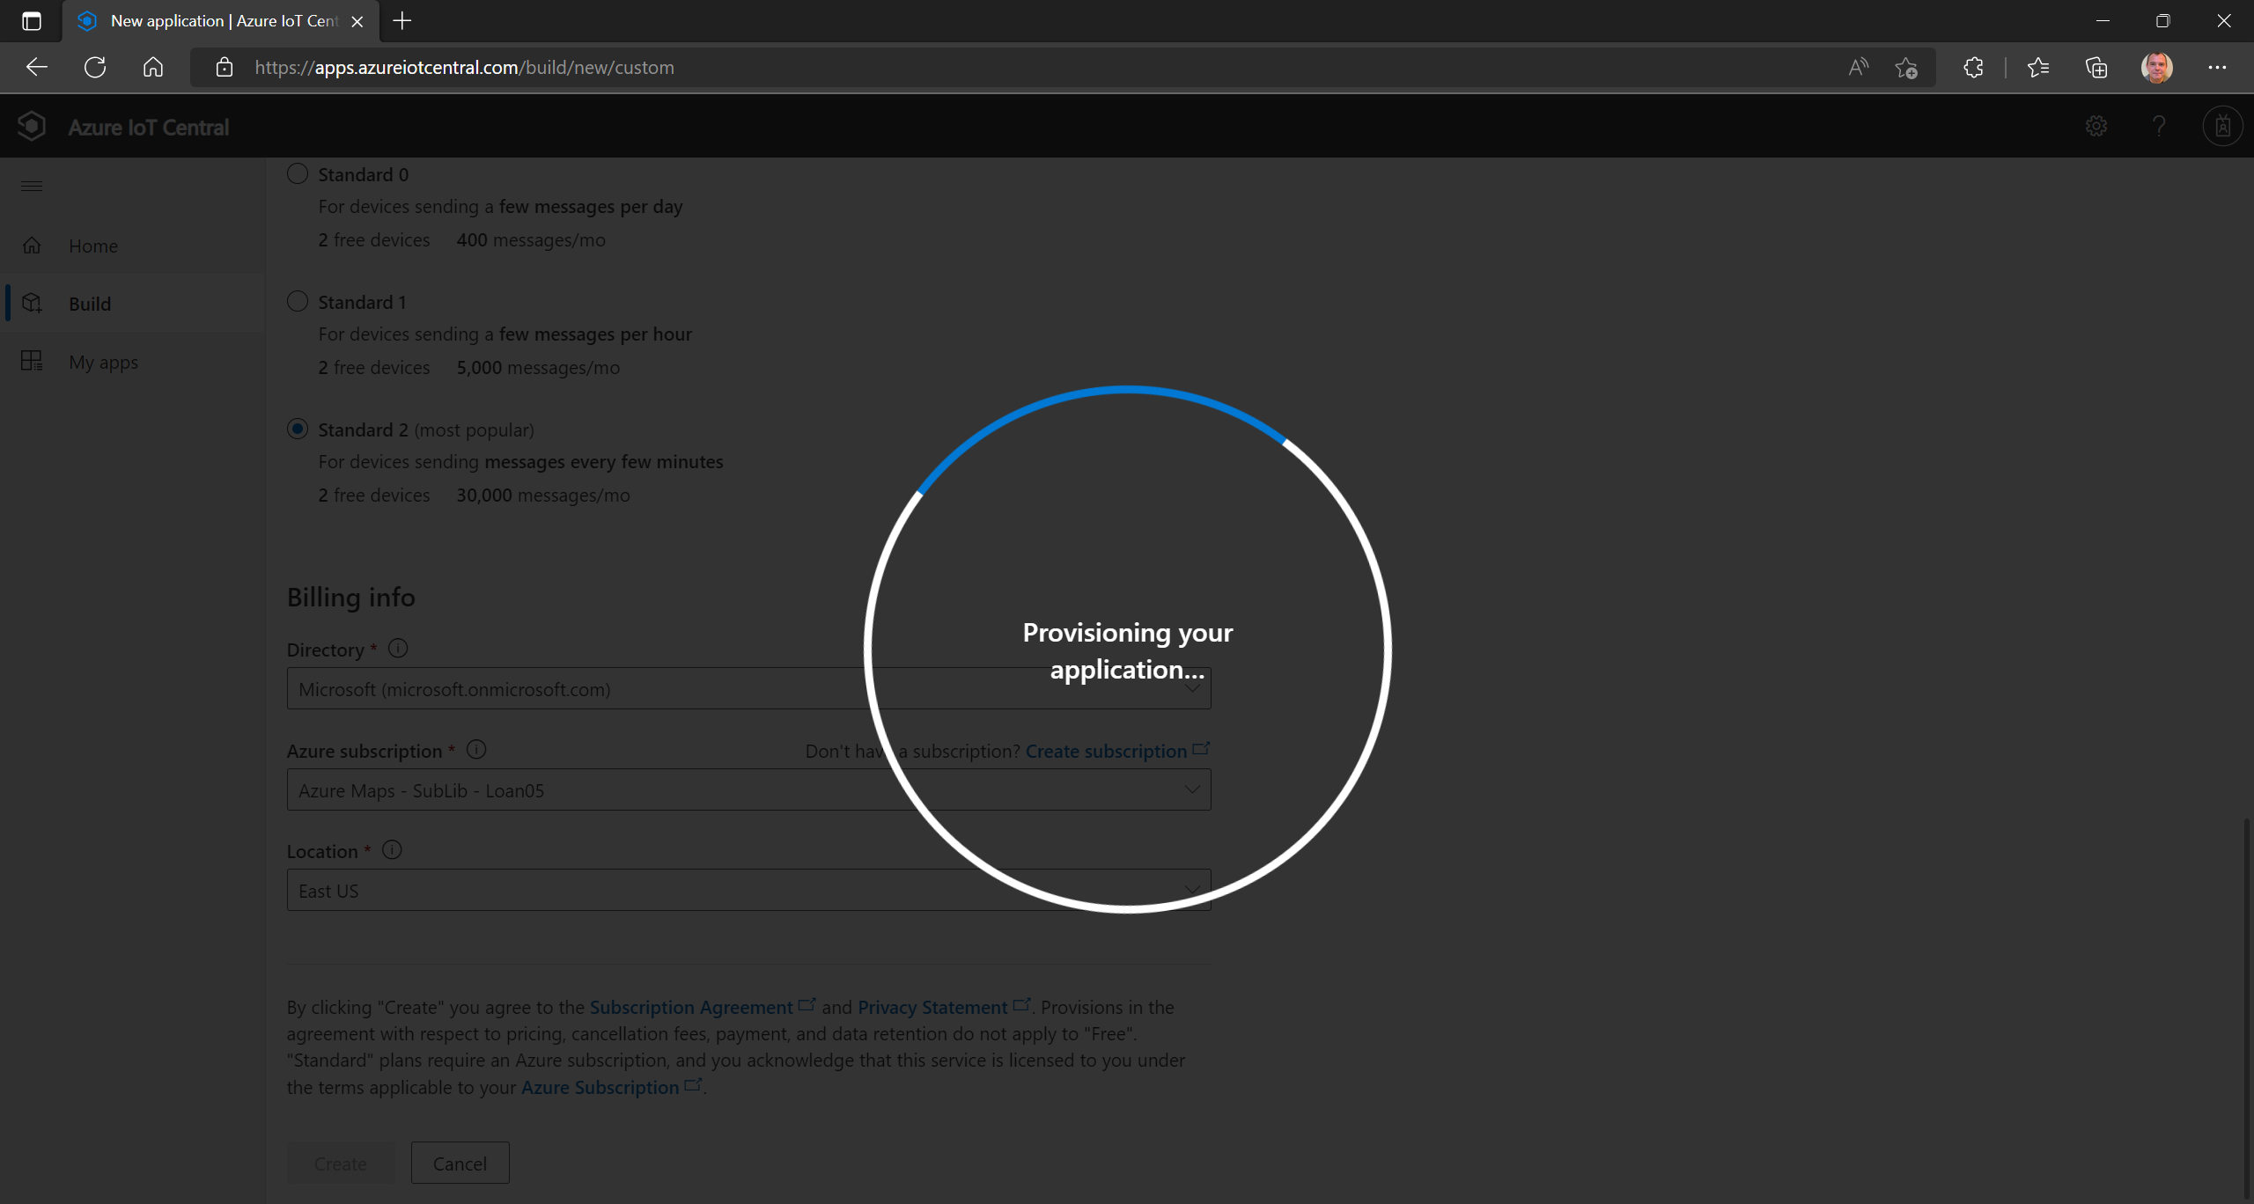
It will take only a short time to deploy all the resources behind the IoT Central app.

Slide 11
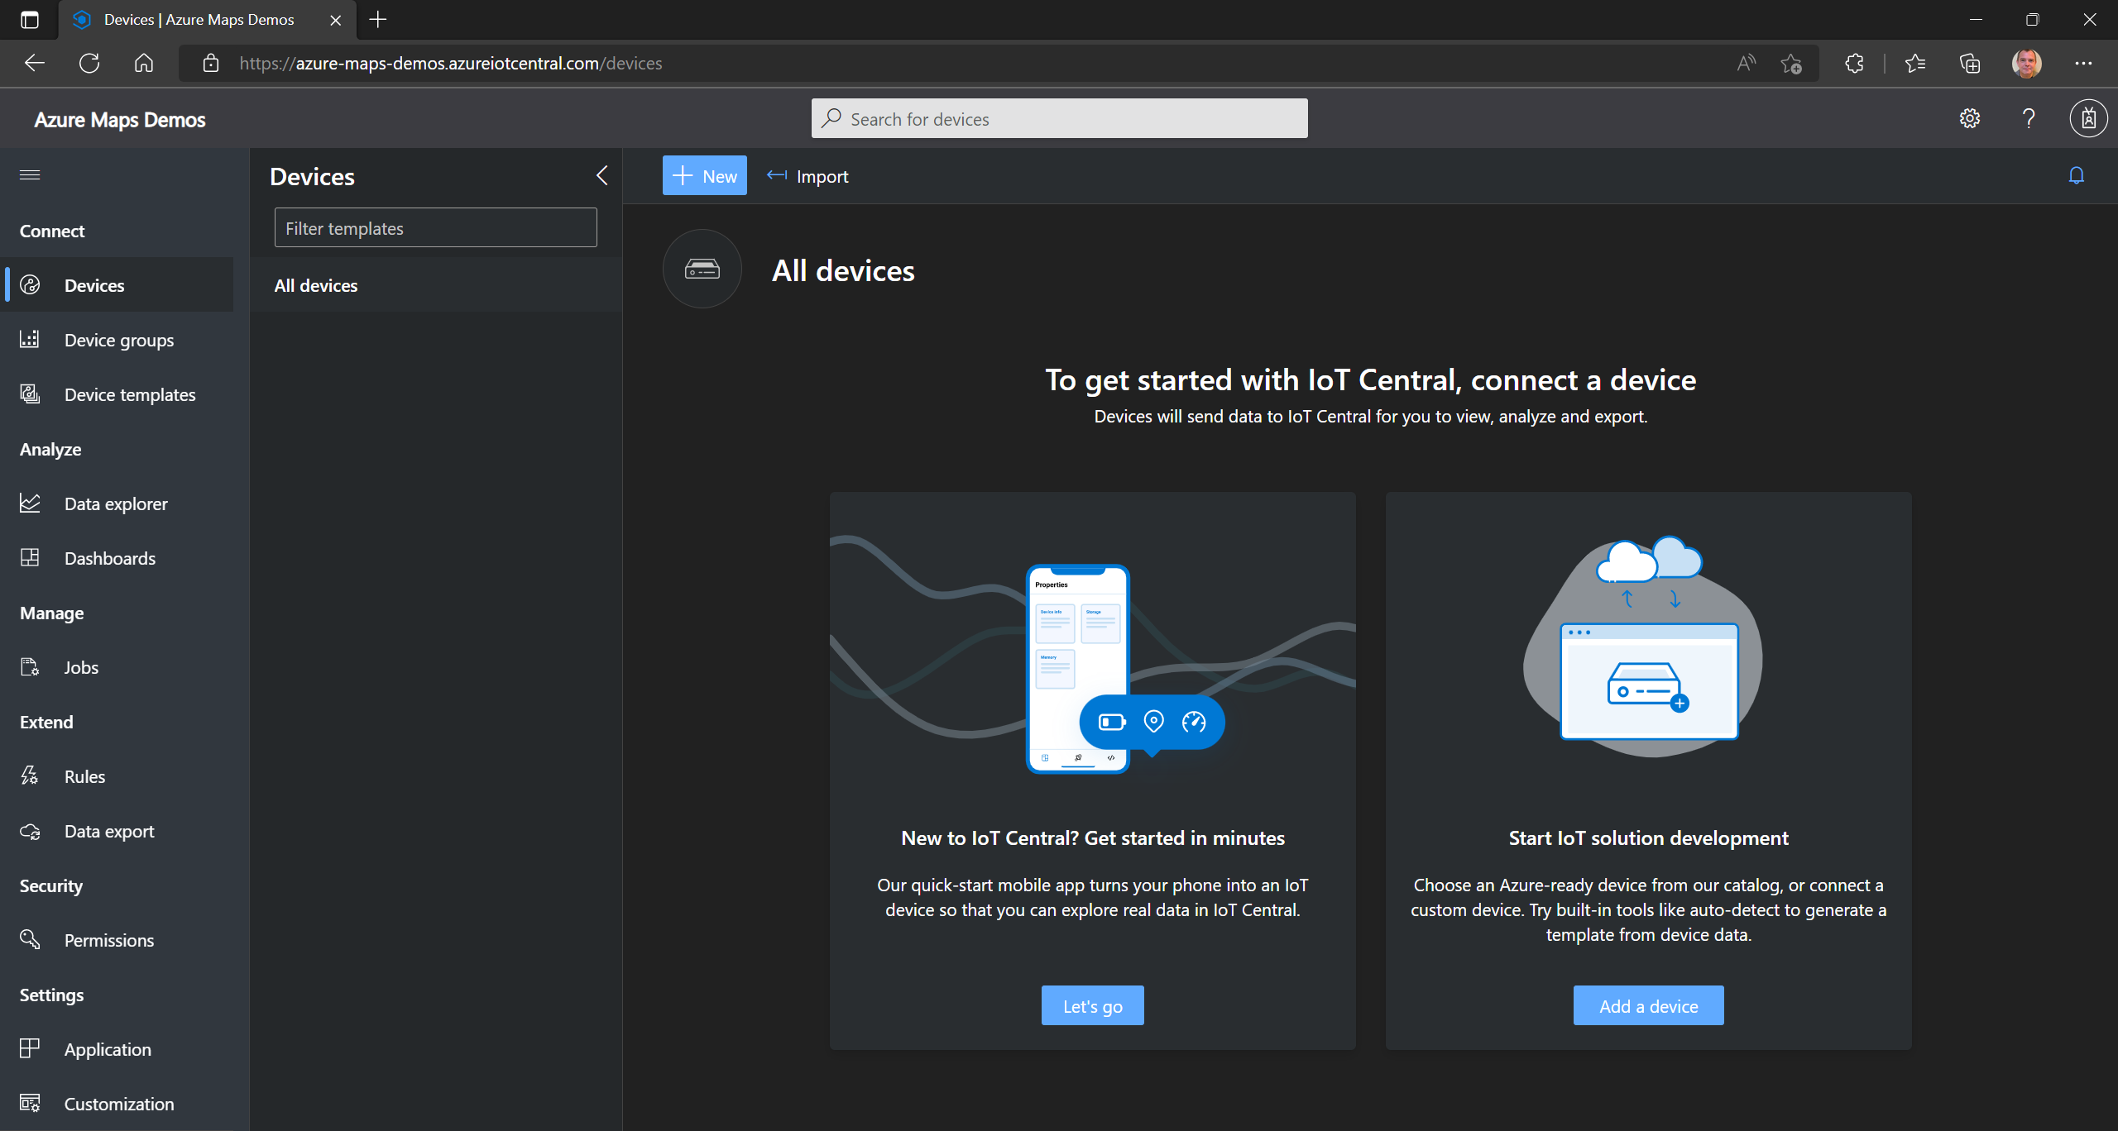

Slide 12
Azure Maps & IoT Central Add Device(s)

Slide 13
Click on [Add a device].

Slide 14
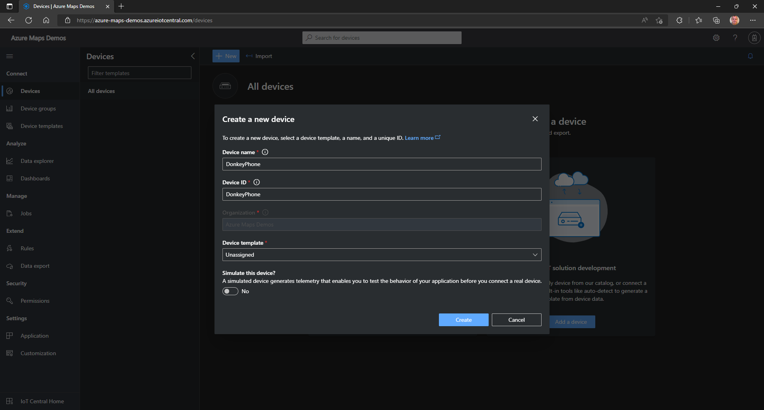
Give the device a name and ID.
Click on [Create].

Slide 15
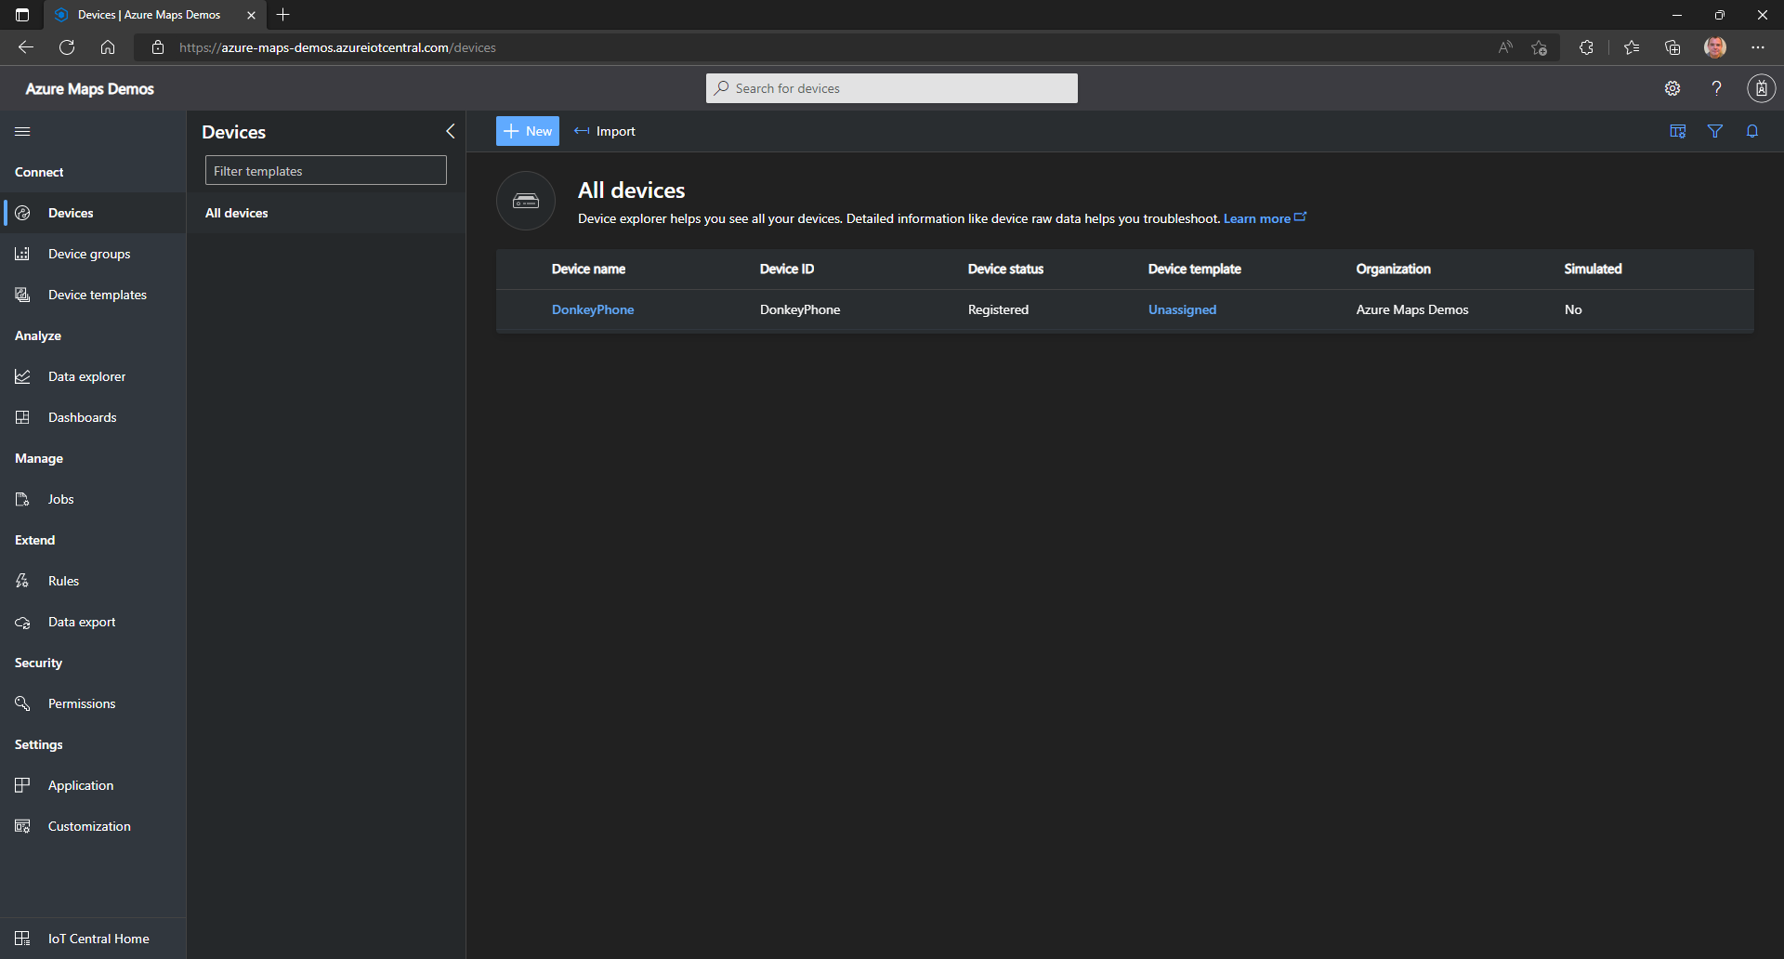
Click on the name of the newly created device.

Slide 16
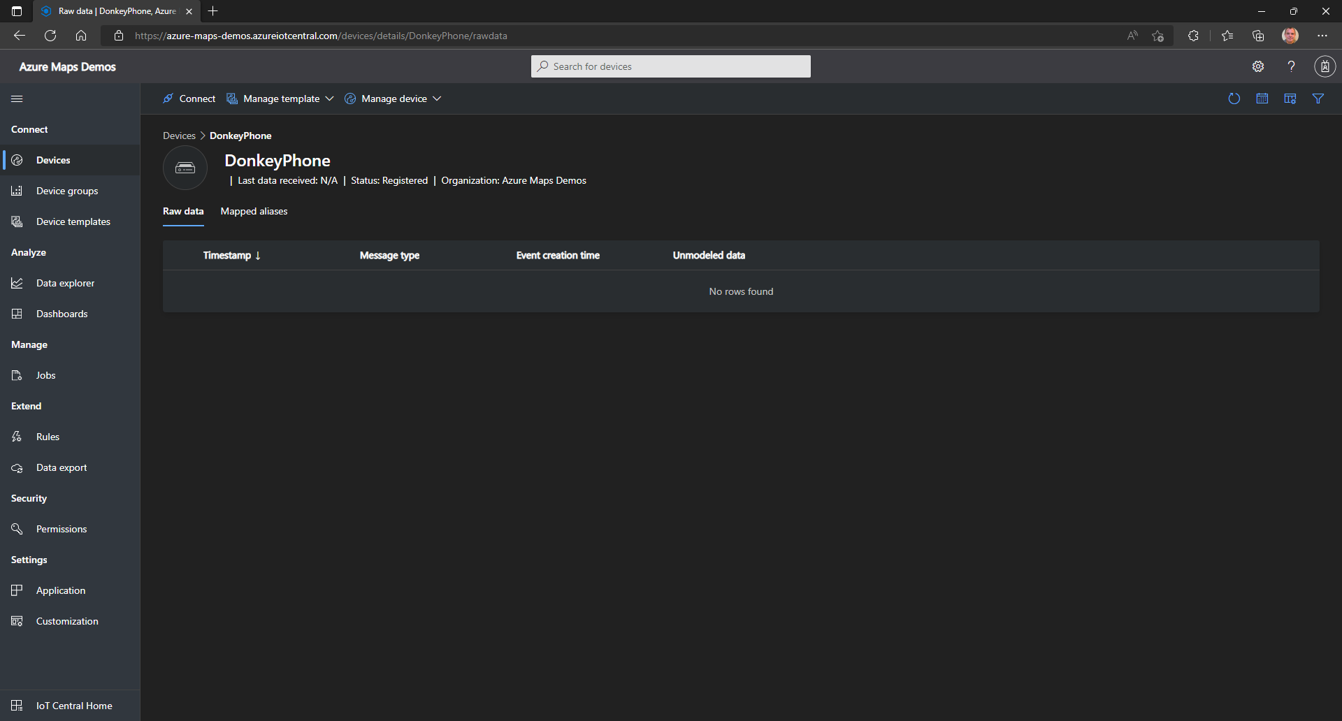
Click on [Connect].

Slide 17
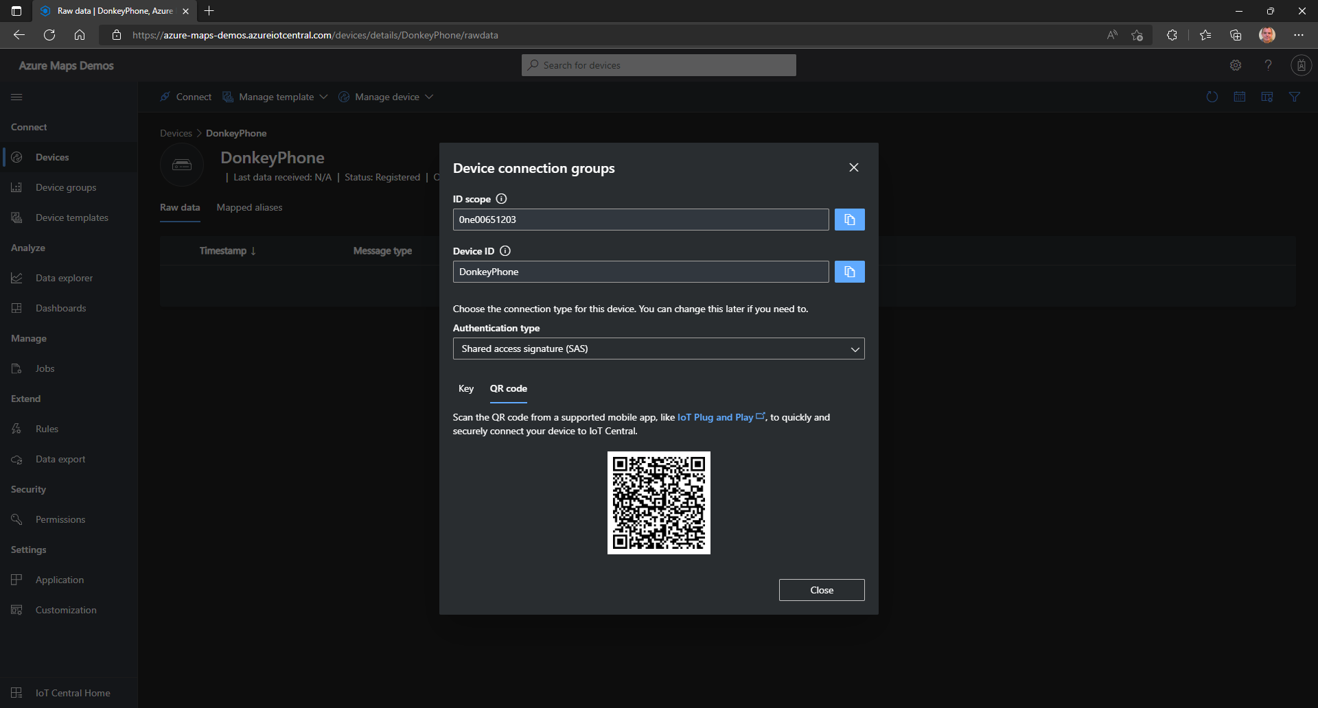
In the dialog that pops up select [QR code].

Slide 18
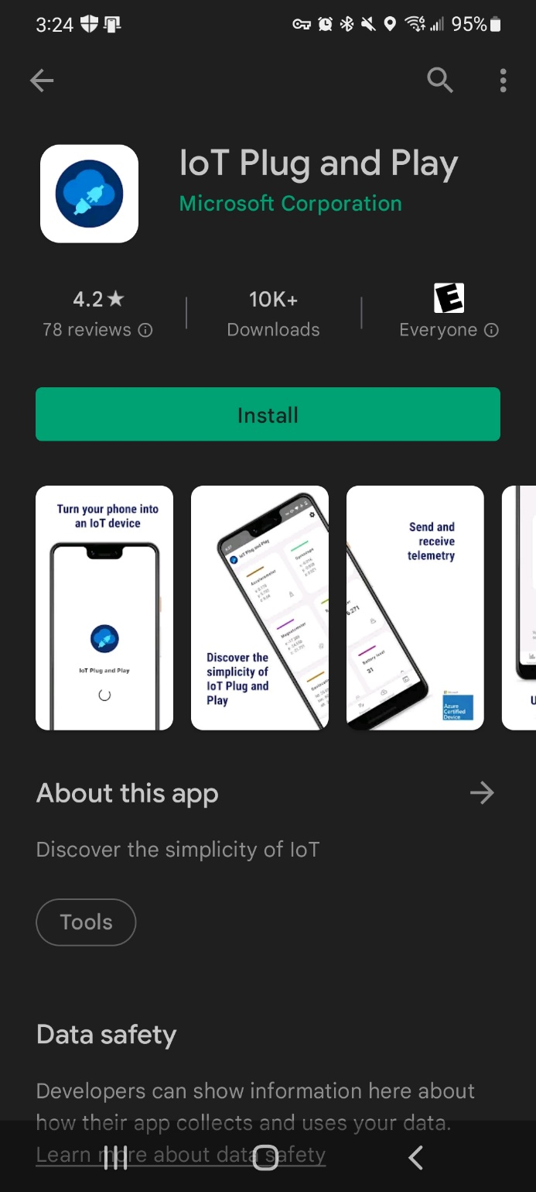
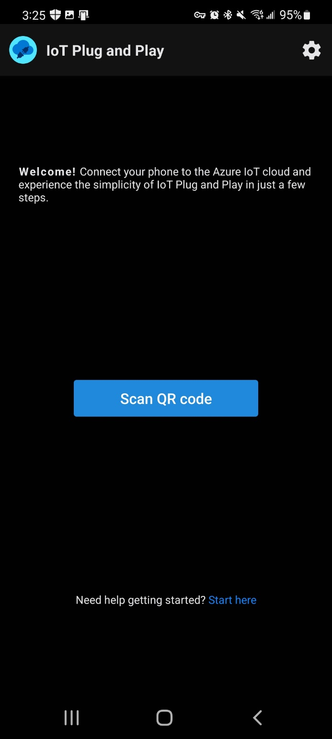
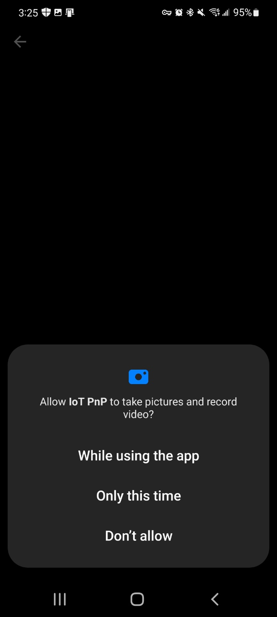
On your mobile device install the IoT Plug and Play application.
Once installed, launch the app and you’re prompted to scan for a QR code.
Confirm that the app can use the device’s camera.

Slide 19
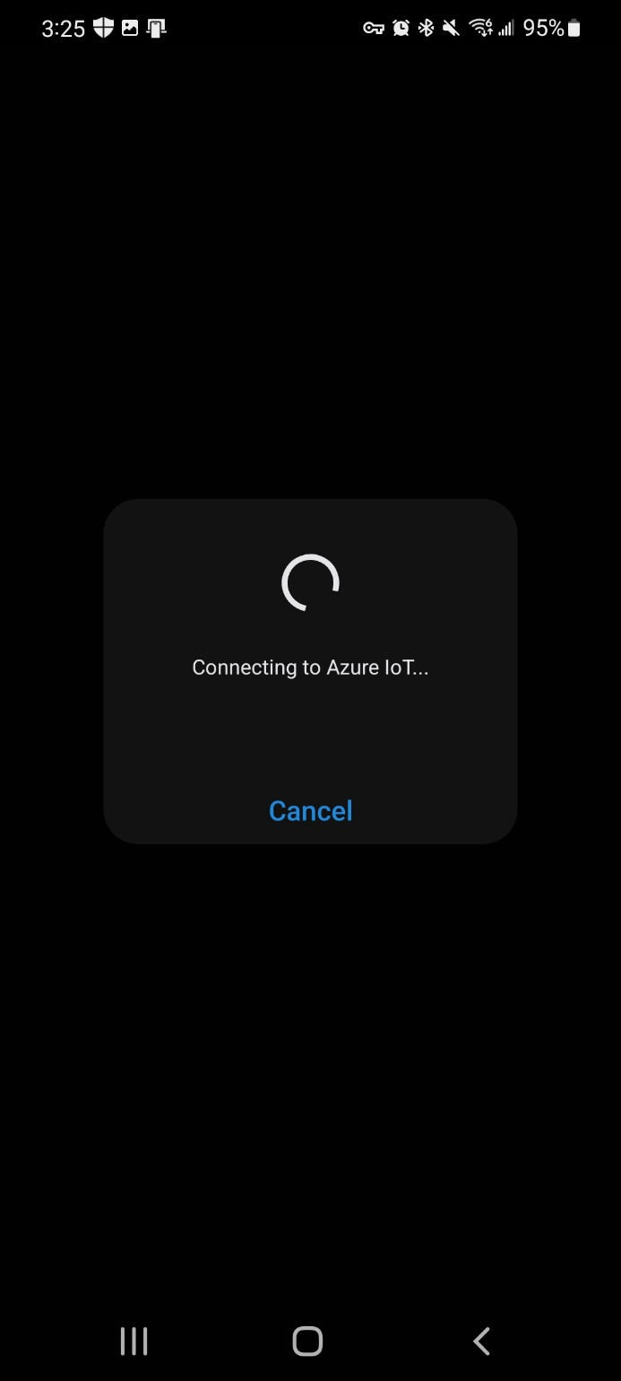
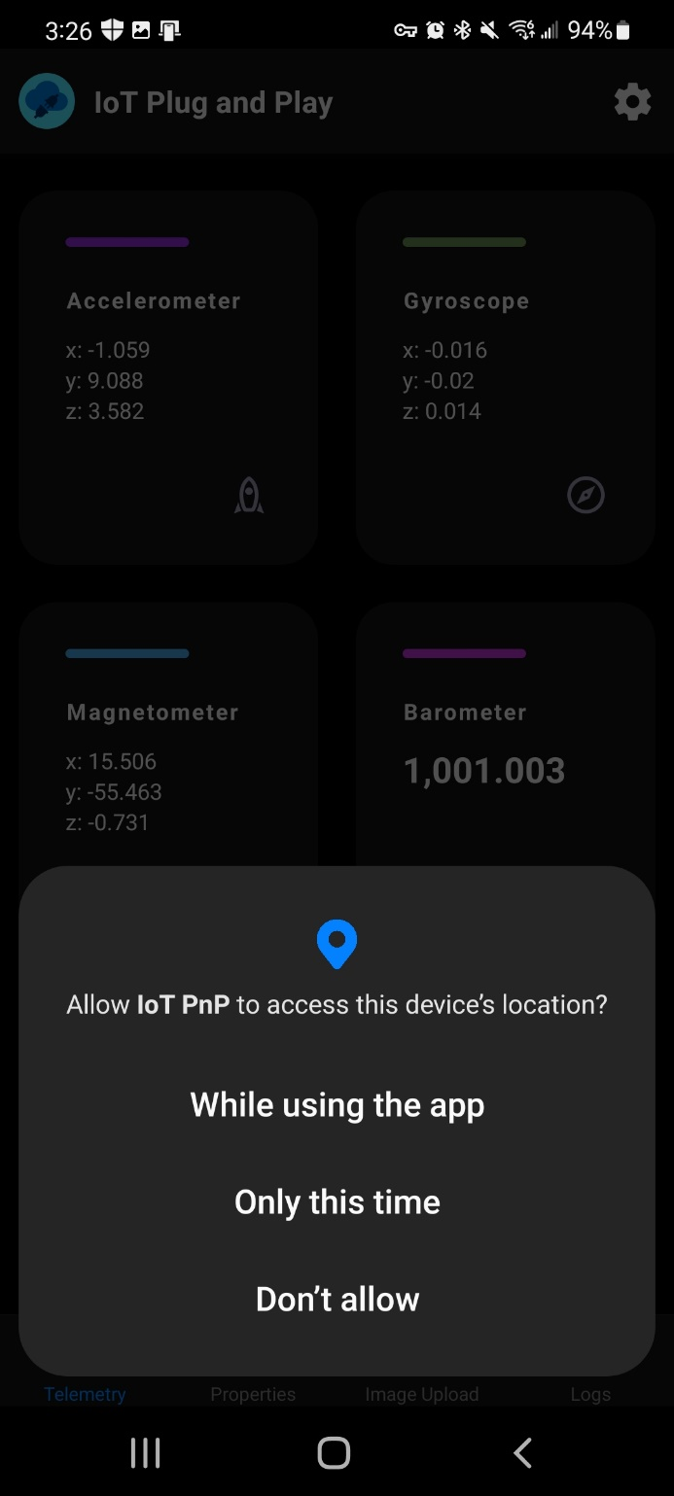
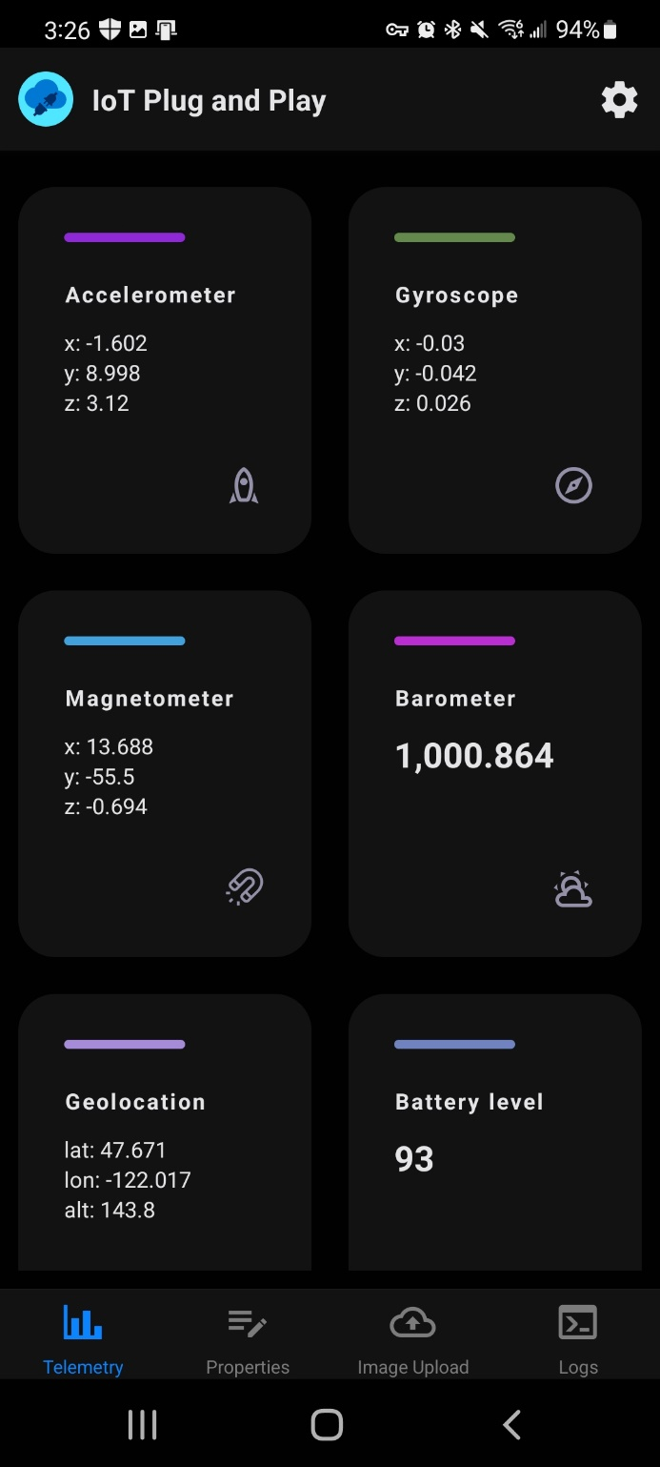
Scan the QR code in IoT Central.
Once the QR code was recognized the app will connect to IoT Central.
Confirm that the app can use the device’s location.

Slide 20
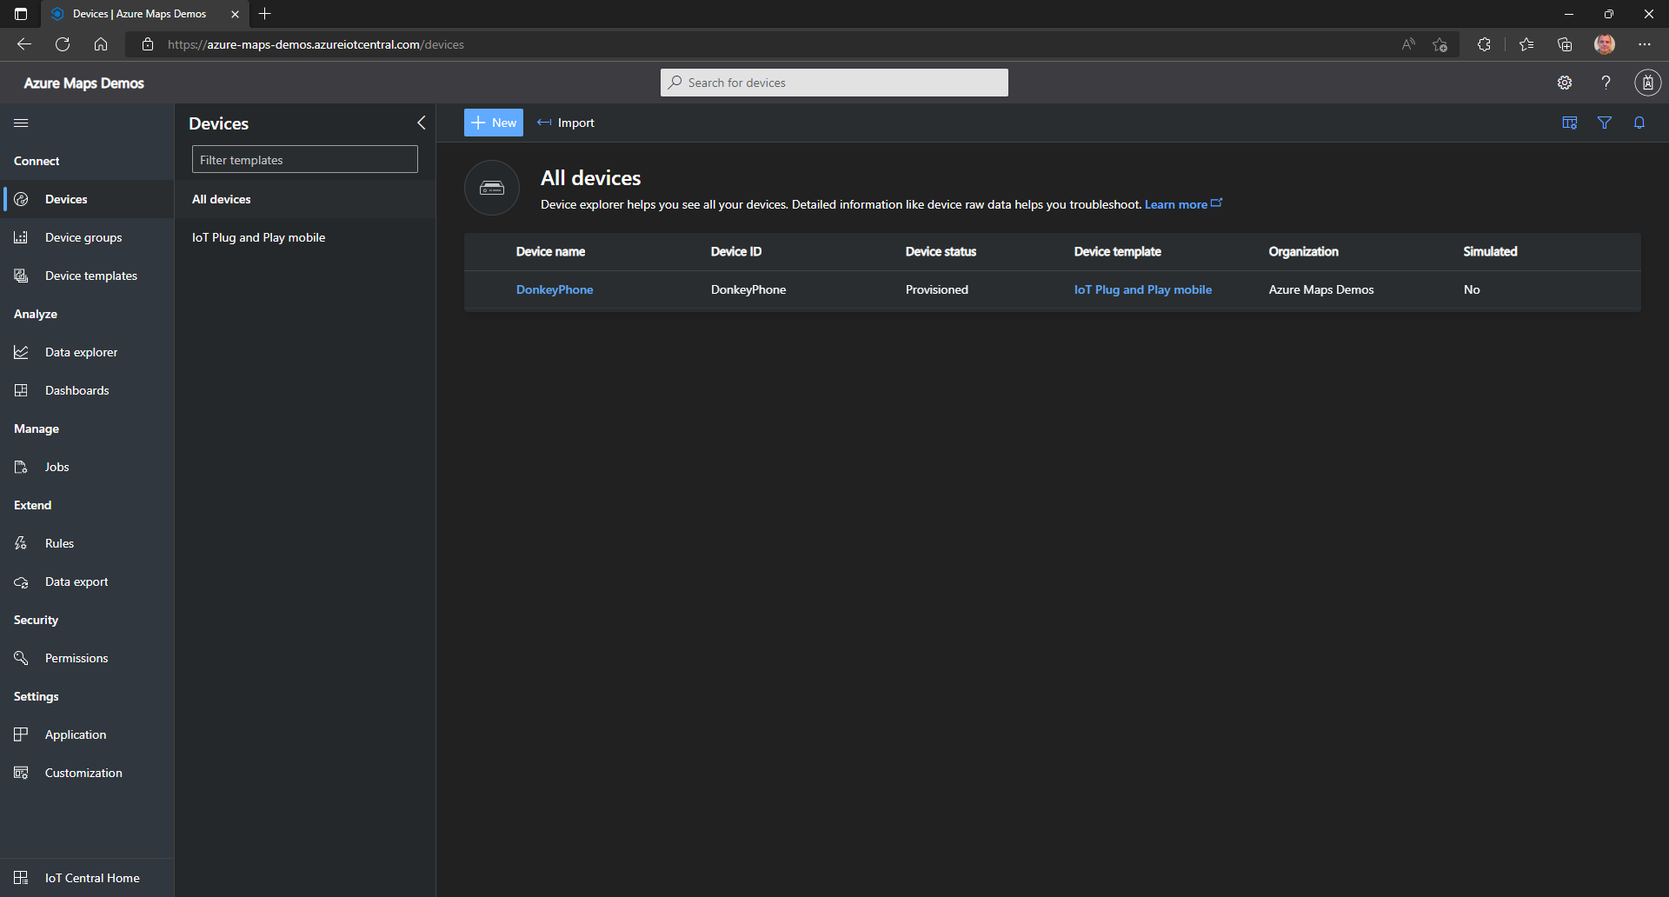
In IoT Central go back to devices and select your device again.

Slide 21
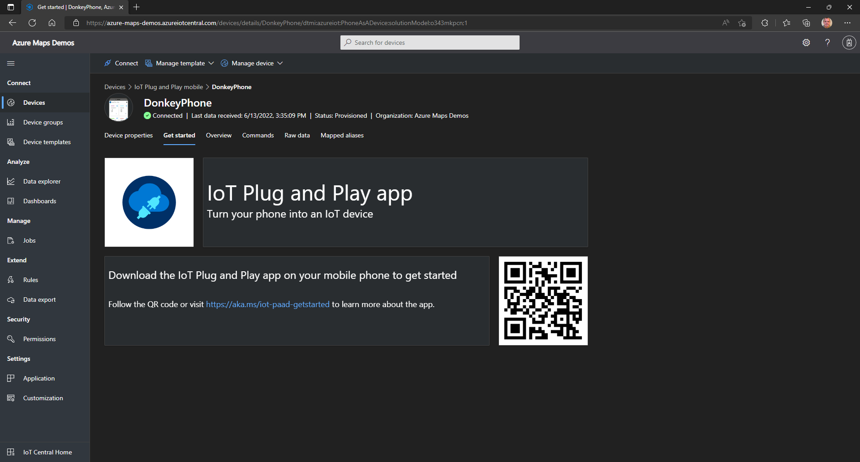
You will find that an IoT Plug and Play template has been applied.

Slide 22
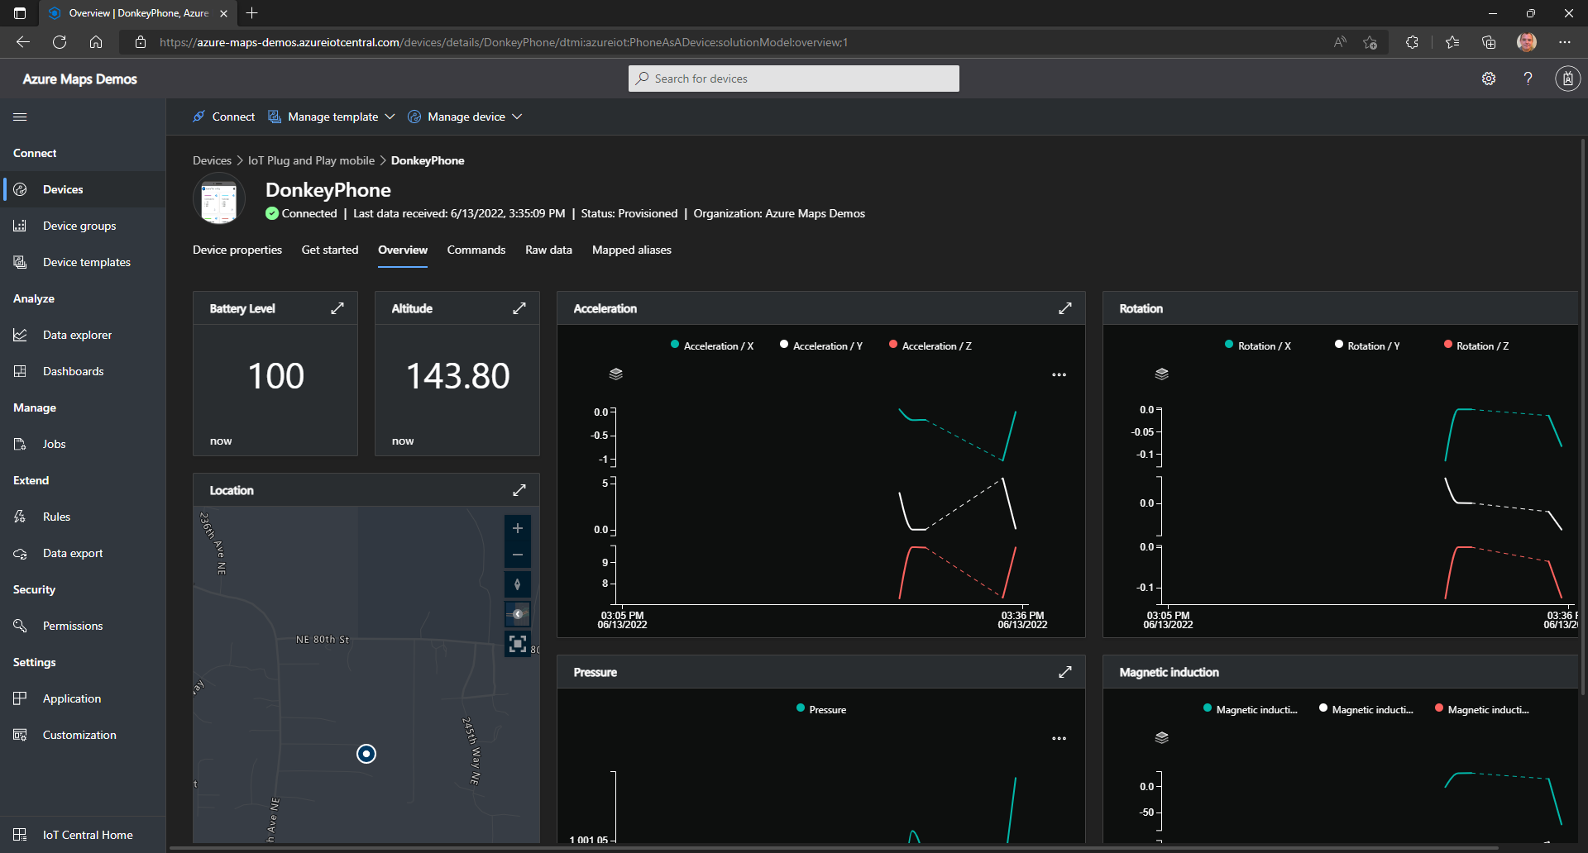
Under Overview you can find the telemetry data coming from the device. In a dashboard that is customized for the template.

Slide 23
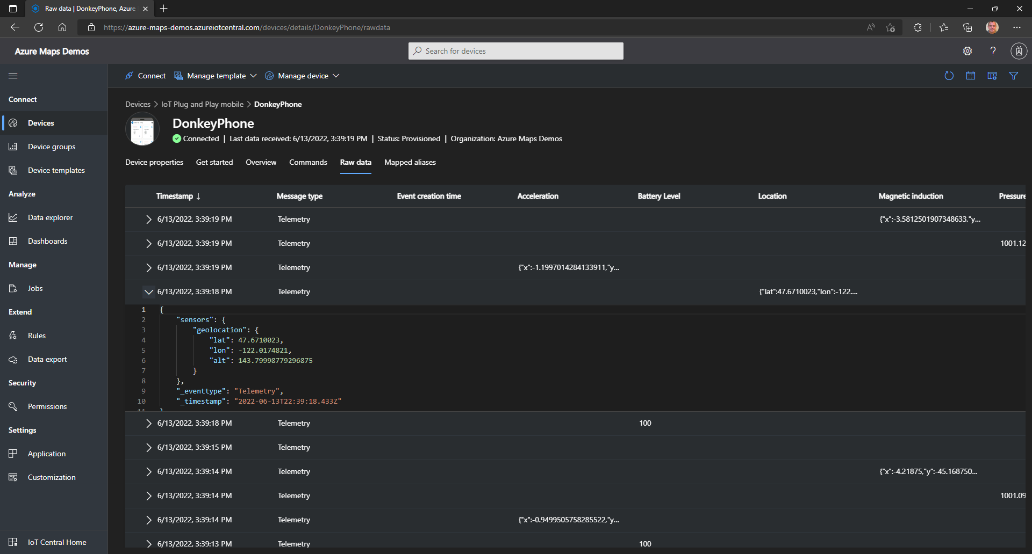
You can also explore the Raw data
Notes:
{
"sensors": {
"geolocation": {
"lat": 47.6710023,
"lon": -122.0174821,
"alt": 143.79998779296875
}
},
"_eventtype": "Telemetry",
"_timestamp": "2022-06-13T22:39:18.433Z"
}

Slide 24
Azure Maps & IoT Central Create Azure Web PubSub

Slide 25
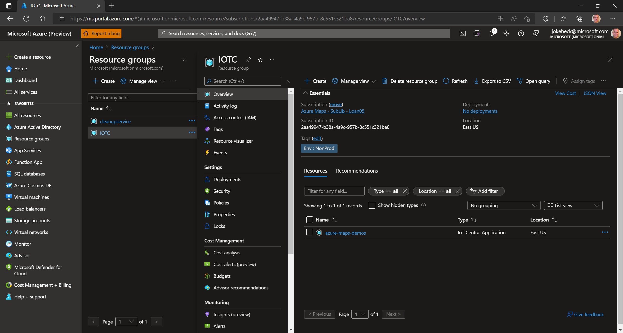
Navigate to the Azure Portal and there to the resource group that was automatically created when you deployed the Azure IoT Central app.

Slide 26
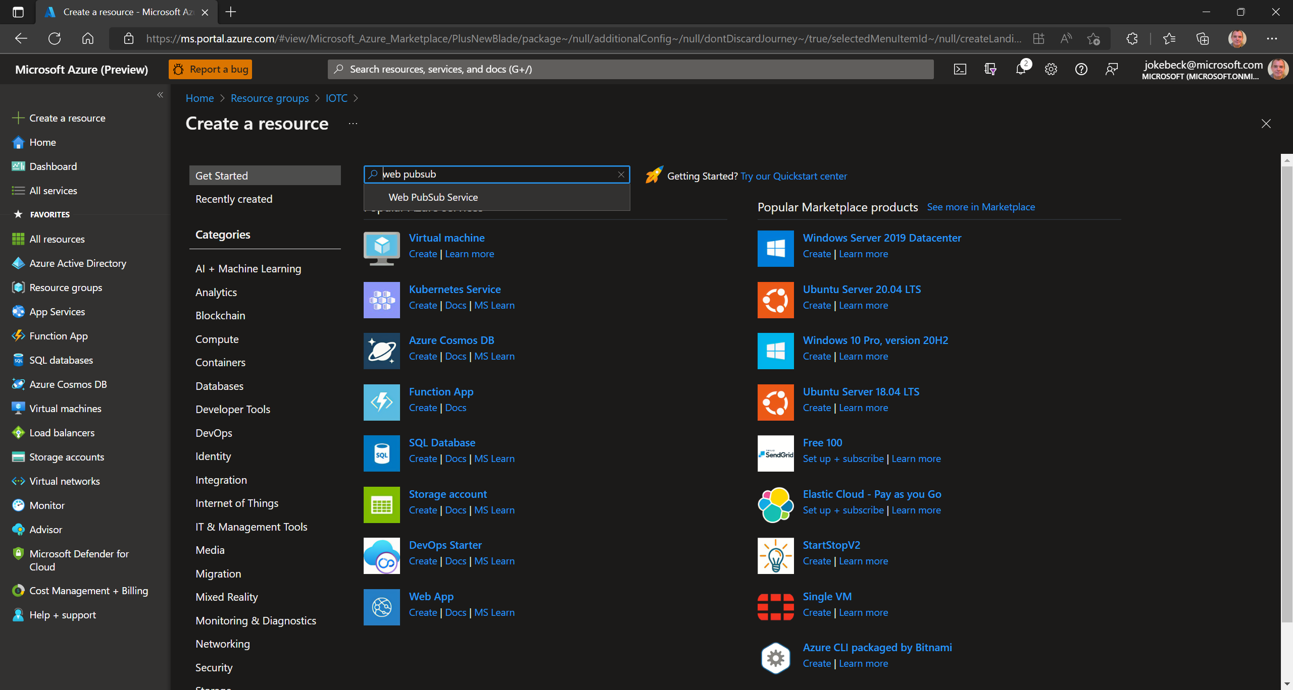
Search for Web PubSub Service

Slide 27
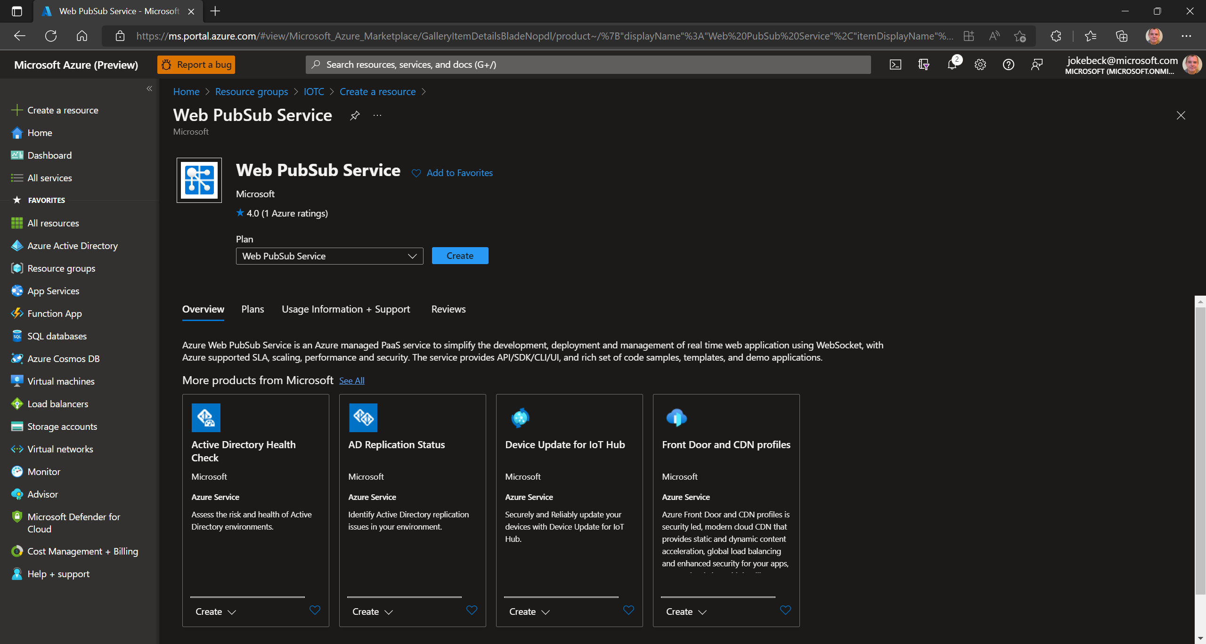
Click on Create

Slide 28
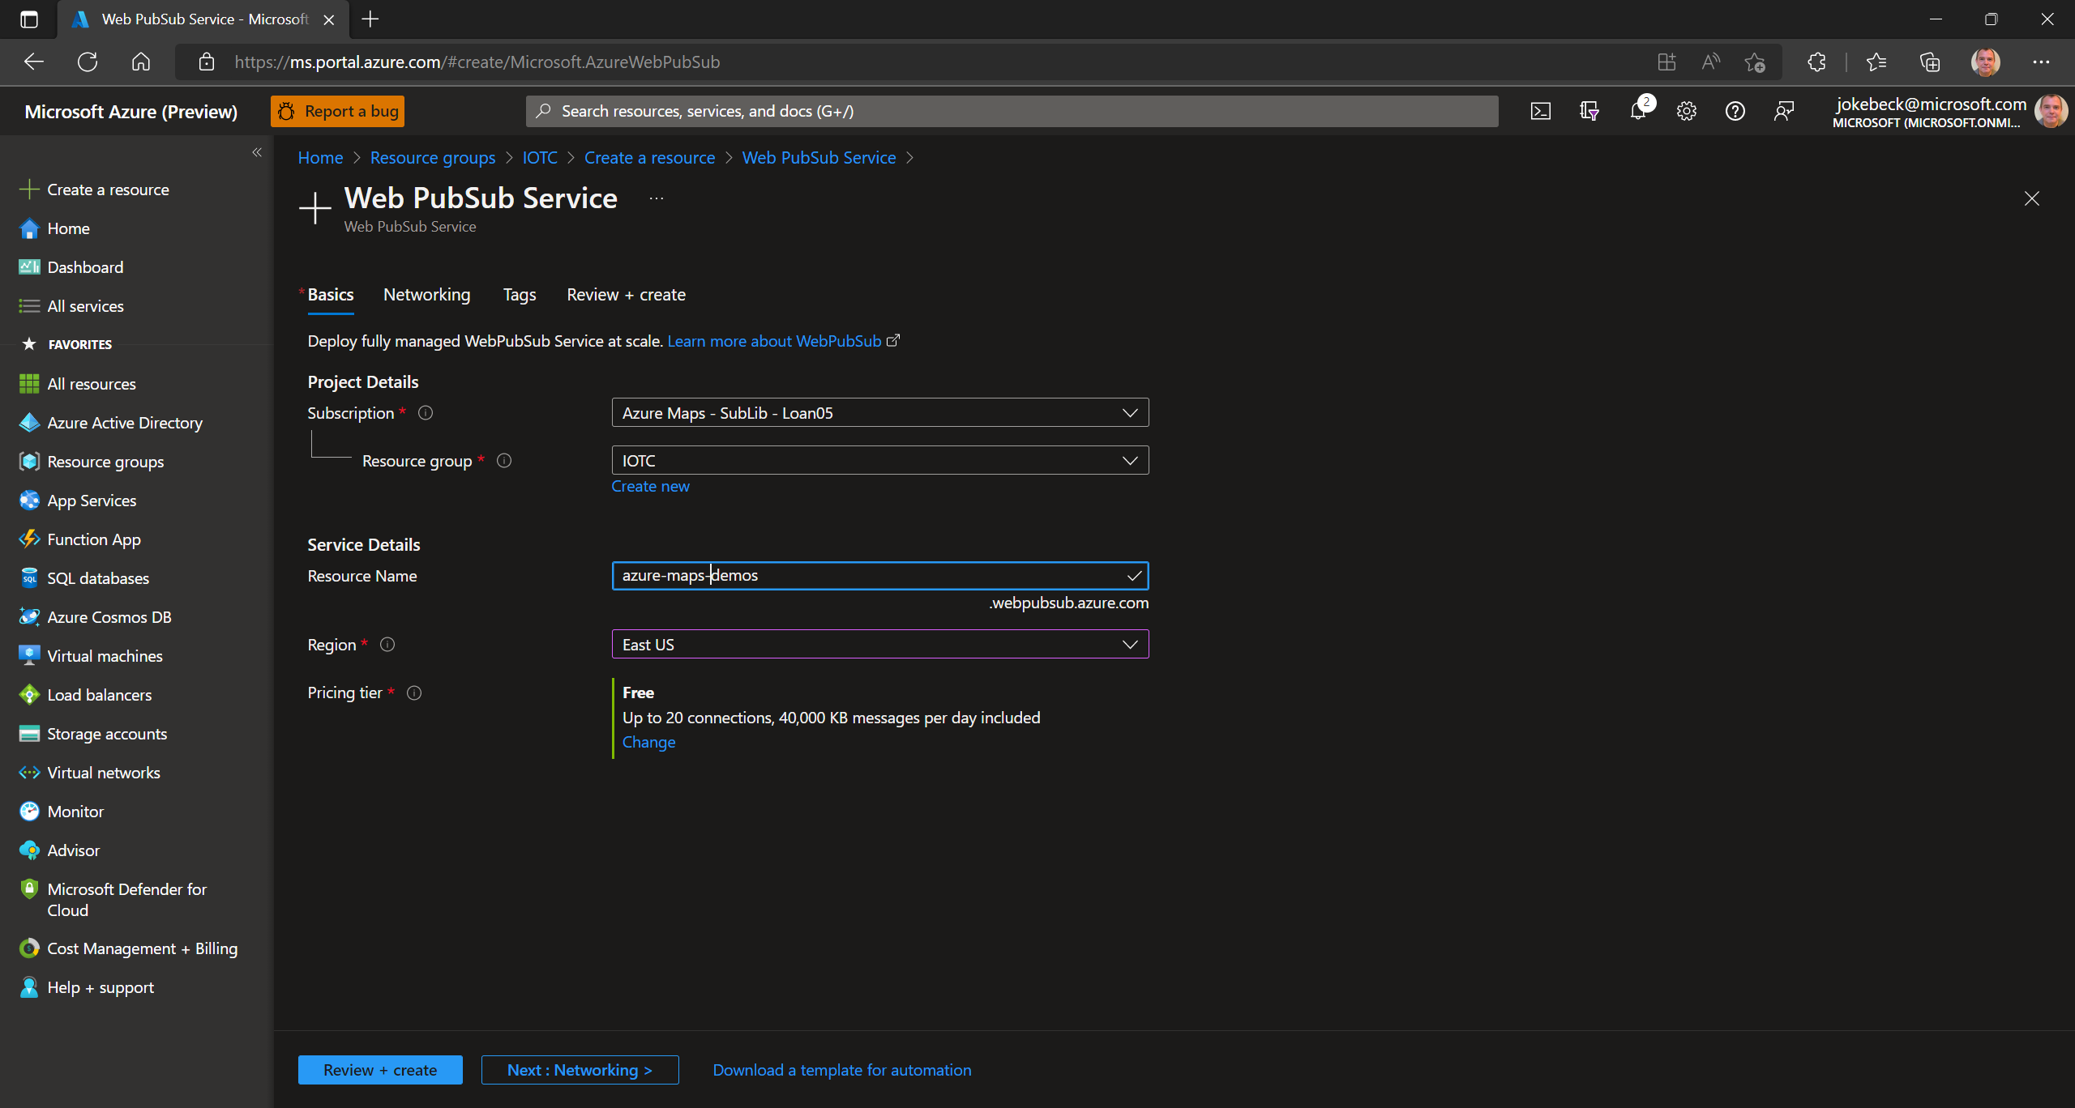
Provide a name for the resource
Select the same region as you used for the IoT Central deployment.
Select a pricing tier (here: free)
Click on [Next : Networking]

Slide 29
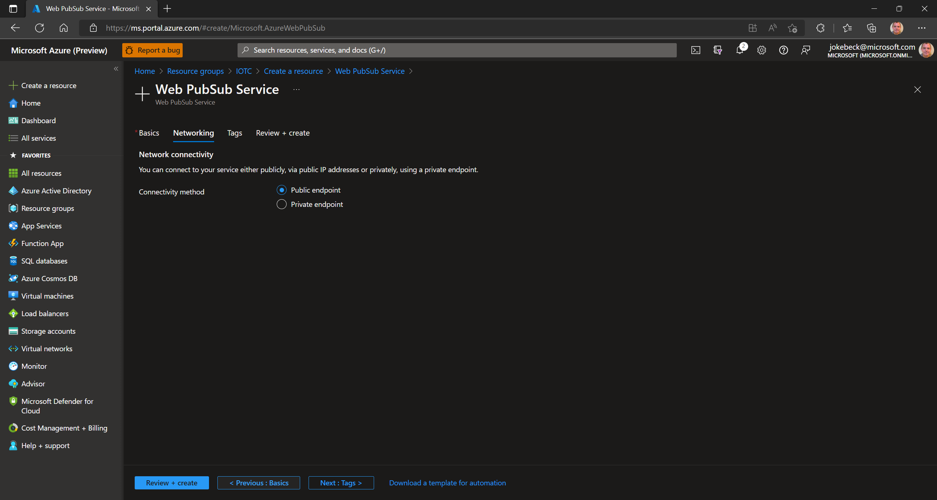
Confirm the public endpoint for the connectivity.
Click [Review and Create].

Slide 30
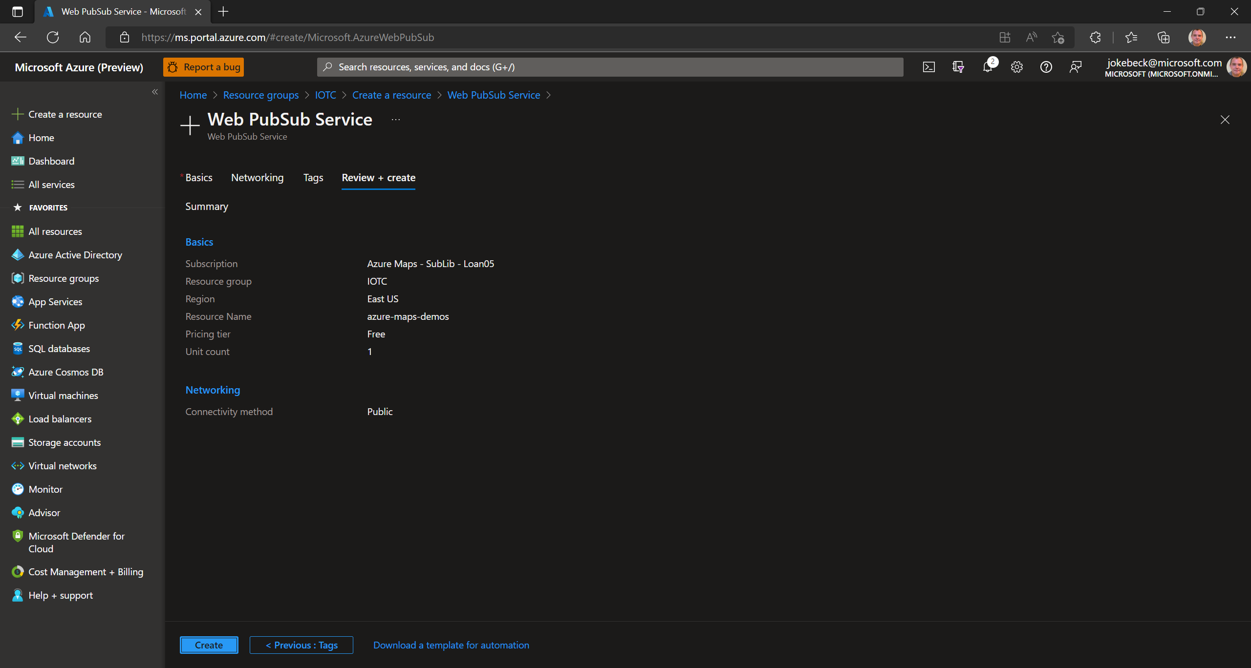
Click [Create].

Slide 31
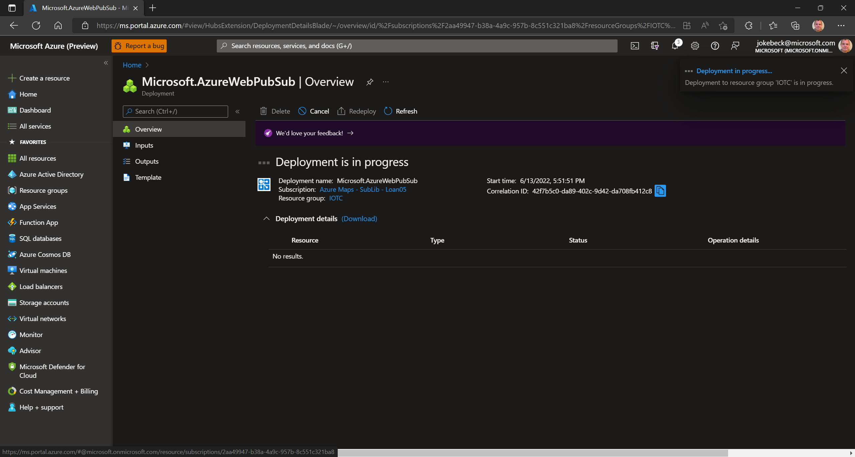
Wait for the deployment to complete.

Slide 32
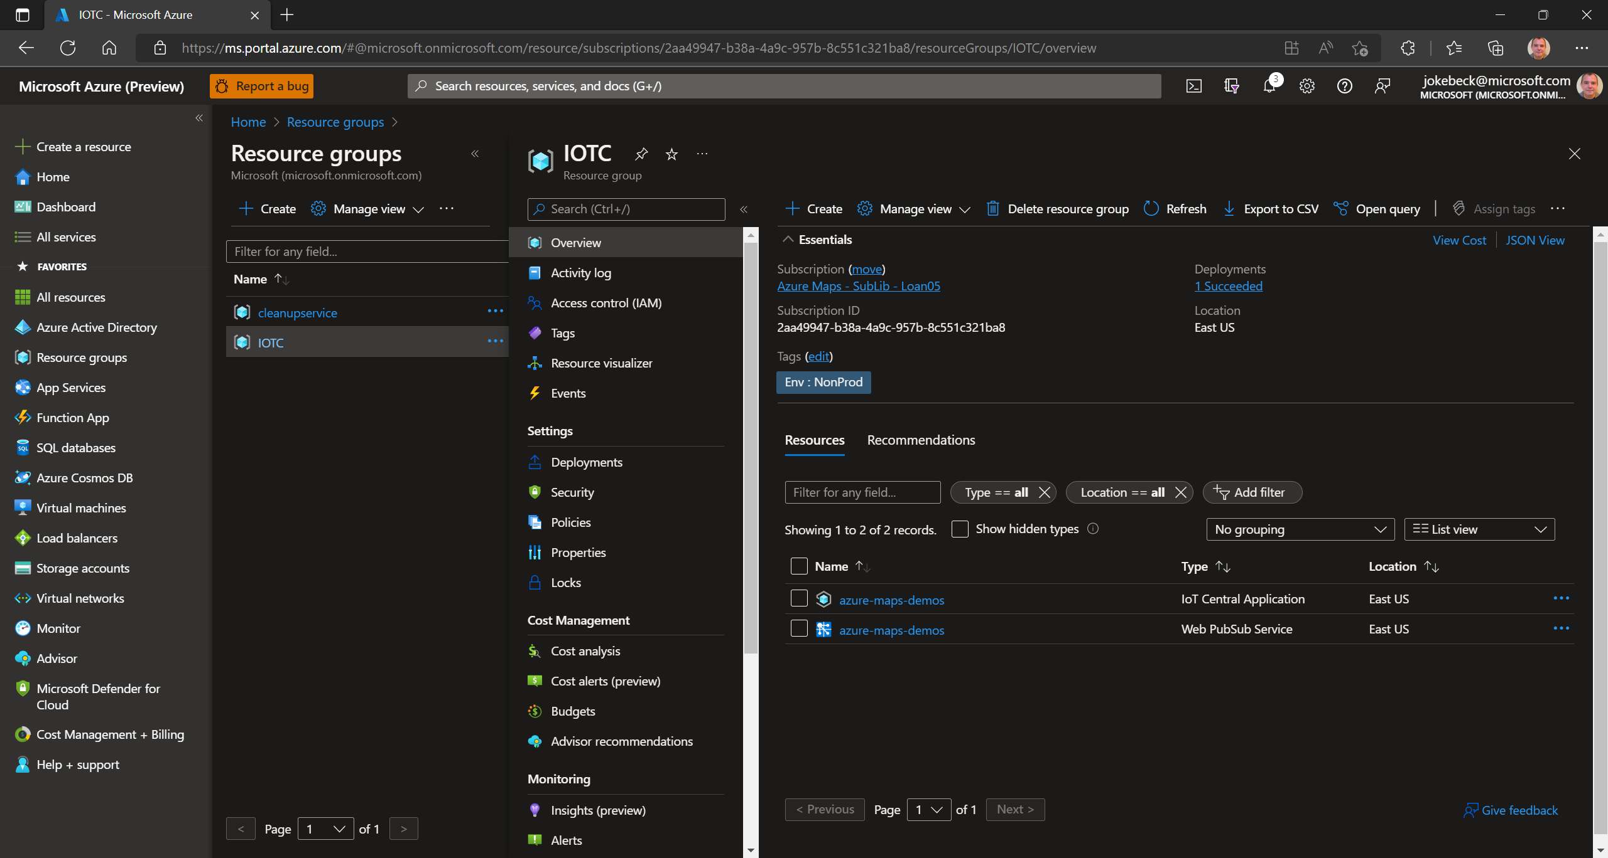
Confirm that the deployment was completed.

Slide 33
Azure Maps & IoT Central Create and Run Azure Functions Locally
Notes:
https://docs.microsoft.com/en-us/azure/azure-web-pubsub/tutorial-serverless-notification?tabs=javascript

Slide 34
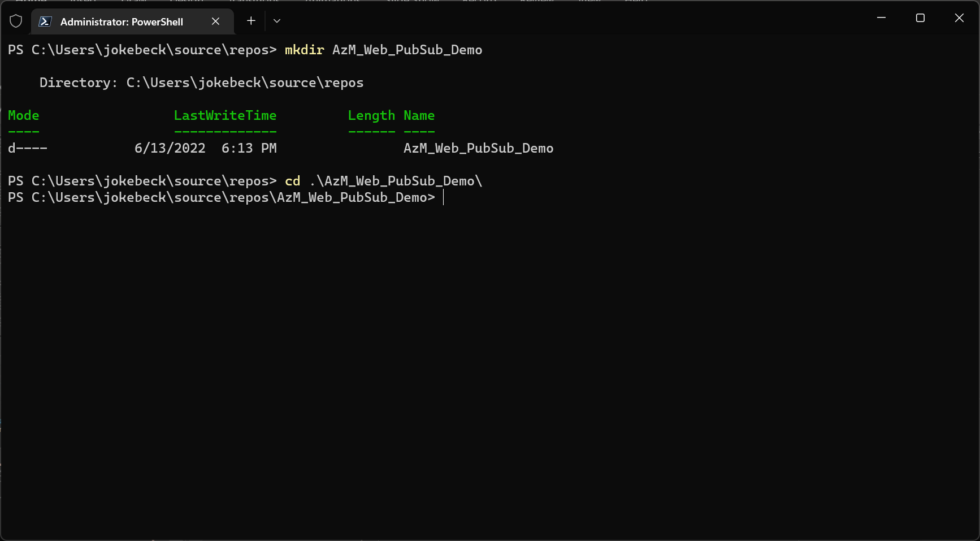
A good strep by step guide to start for Azure Functions connected to Azure Web PubSub is “Create a serverless notification app with Azure Functions and Azure Web PubSub service”. Let’s start with this tutorial and then modify the code to meet our requirements.
Create a new folder for your Azure Function project.
Change into the new directory.

Slide 35
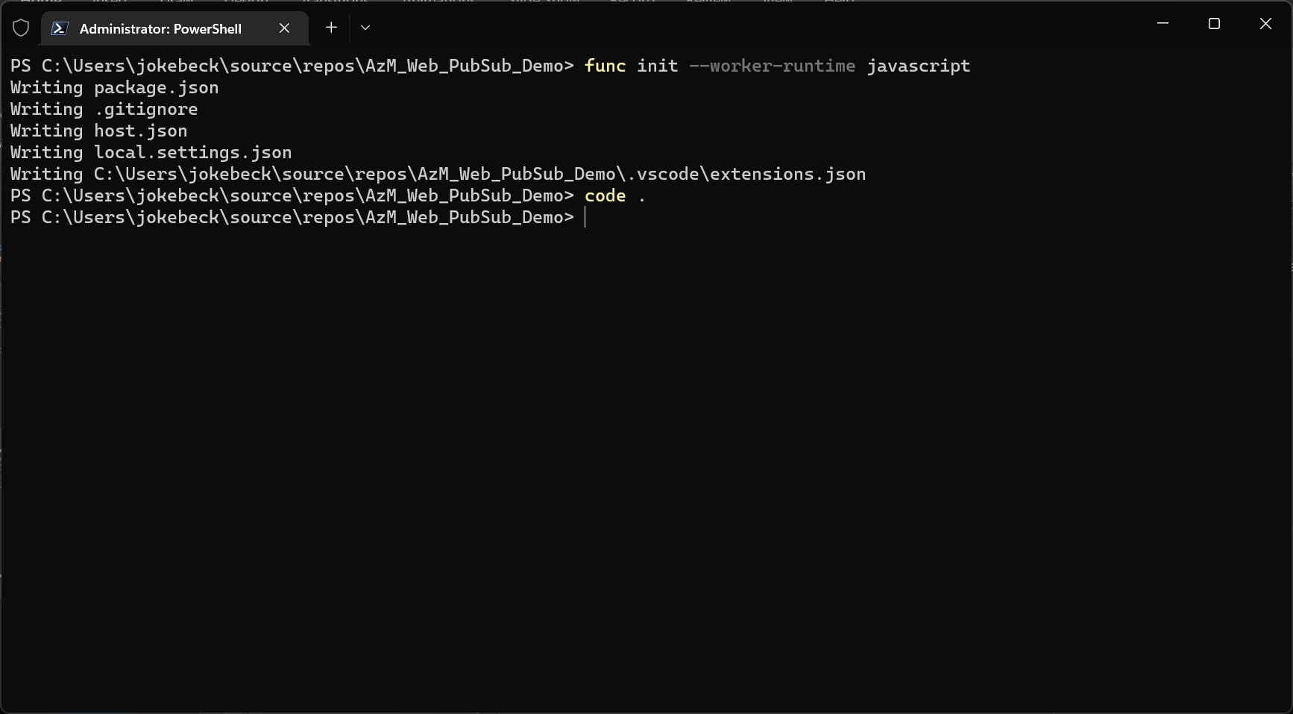
Run the command: func init --worker-runtime javascript
Open Visual Studio Code in this directory.

Slide 36
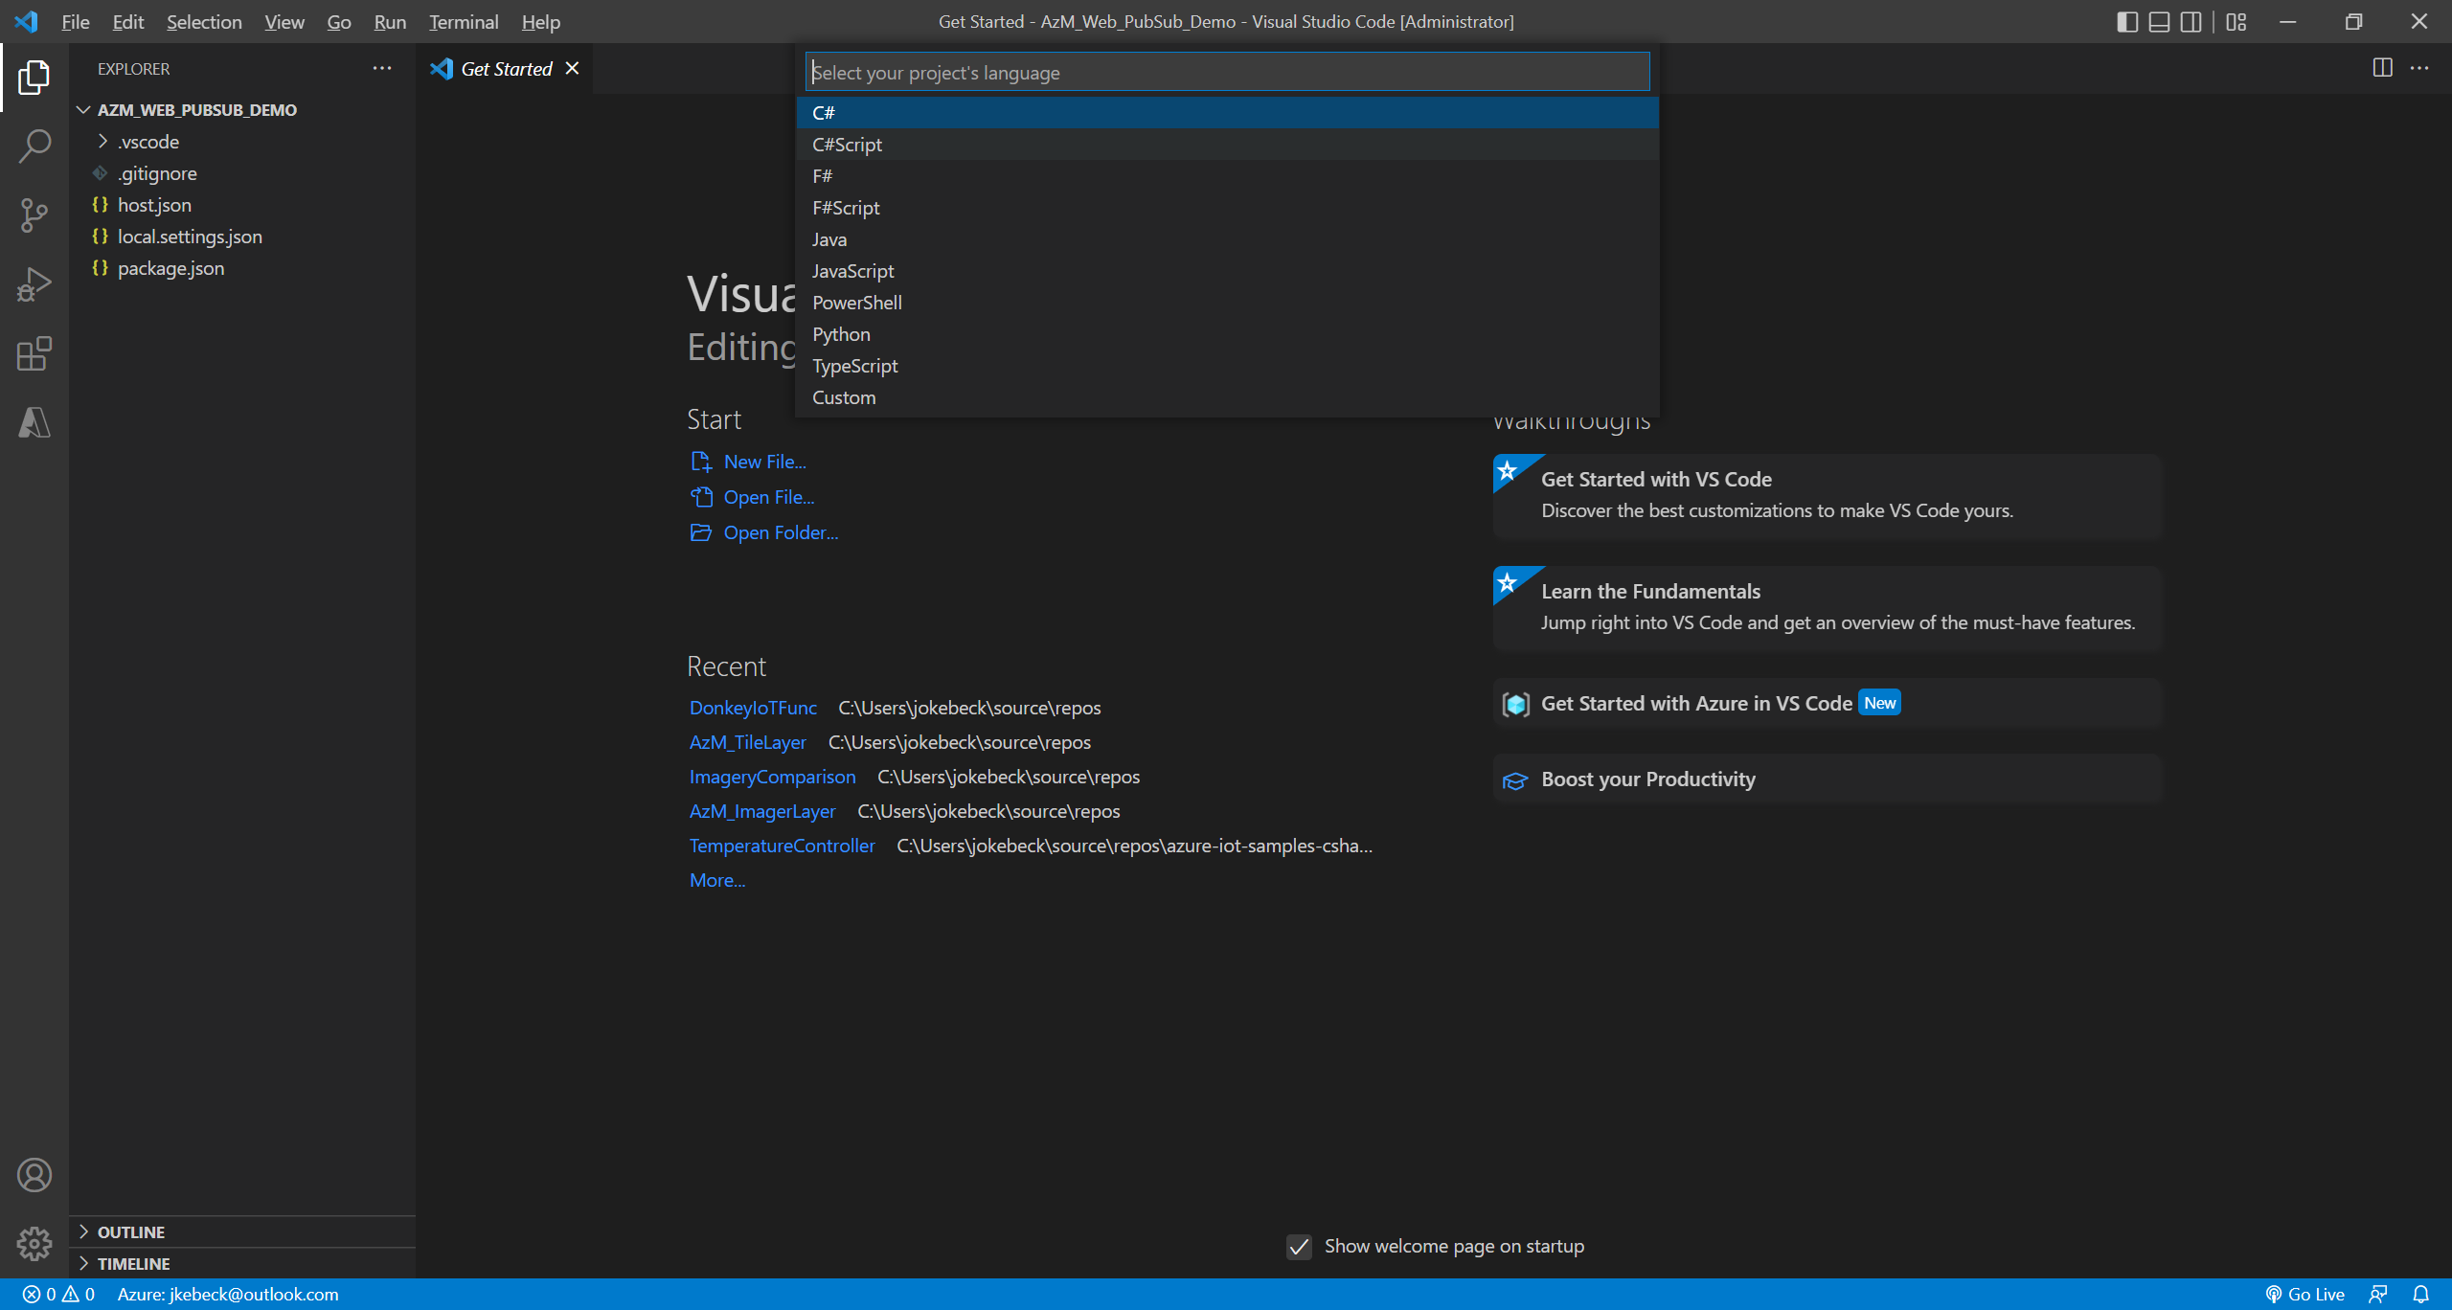
Visual Studio Code will prompt that the function app was created outside of VS Code and ask you to initialize the project.
Select JavaScript as the project’s language.

Slide 37
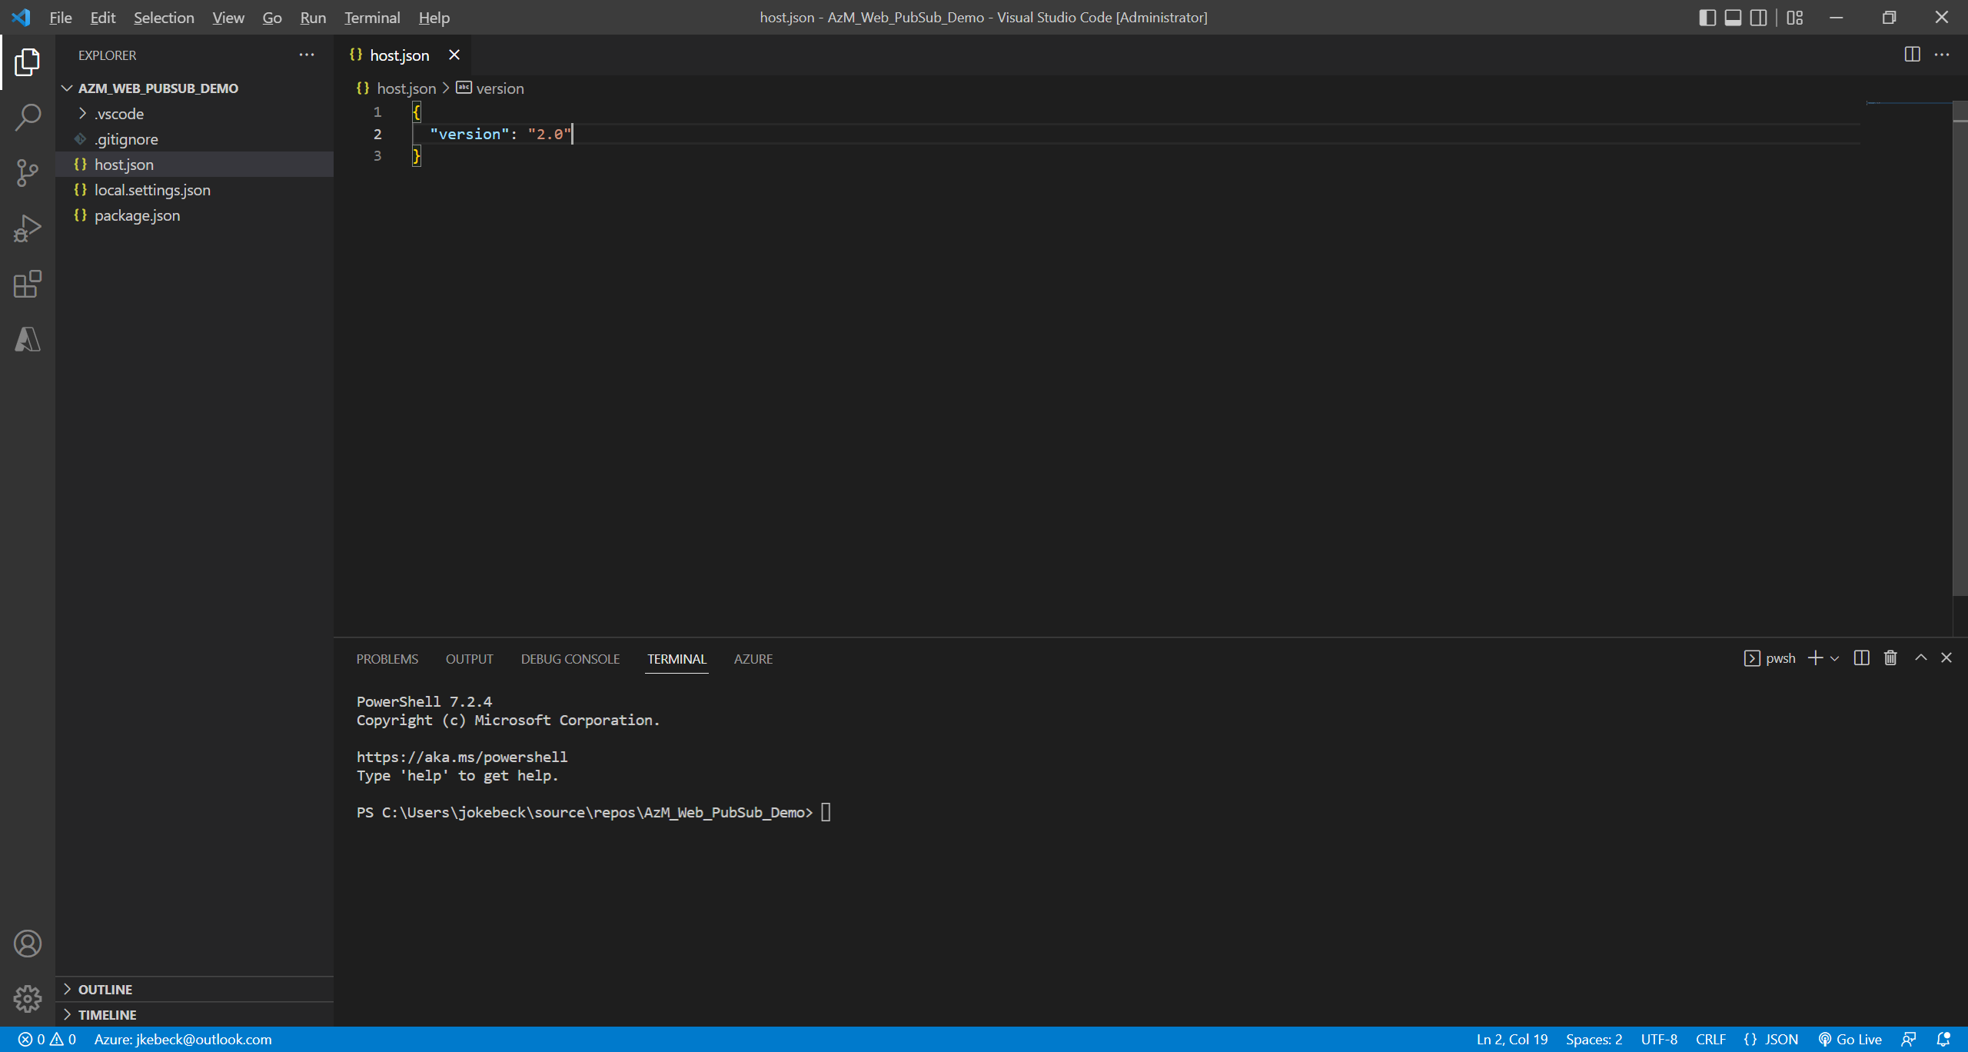
Modify the host.json file:
{
"version": "2.0"
}

Slide 38
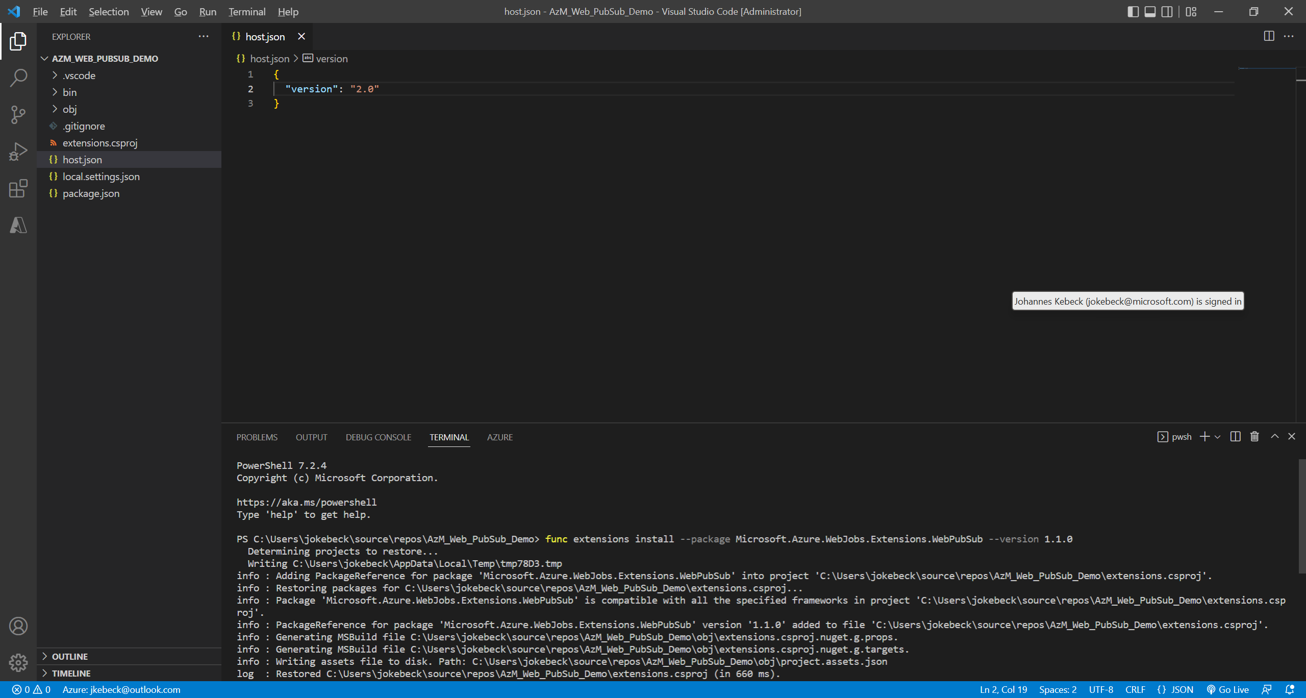
Open the terminal…
… and install the extension package func extensions install --package Microsoft.Azure.WebJobs.Extensions.WebPubSub --version 1.1.0

Slide 39
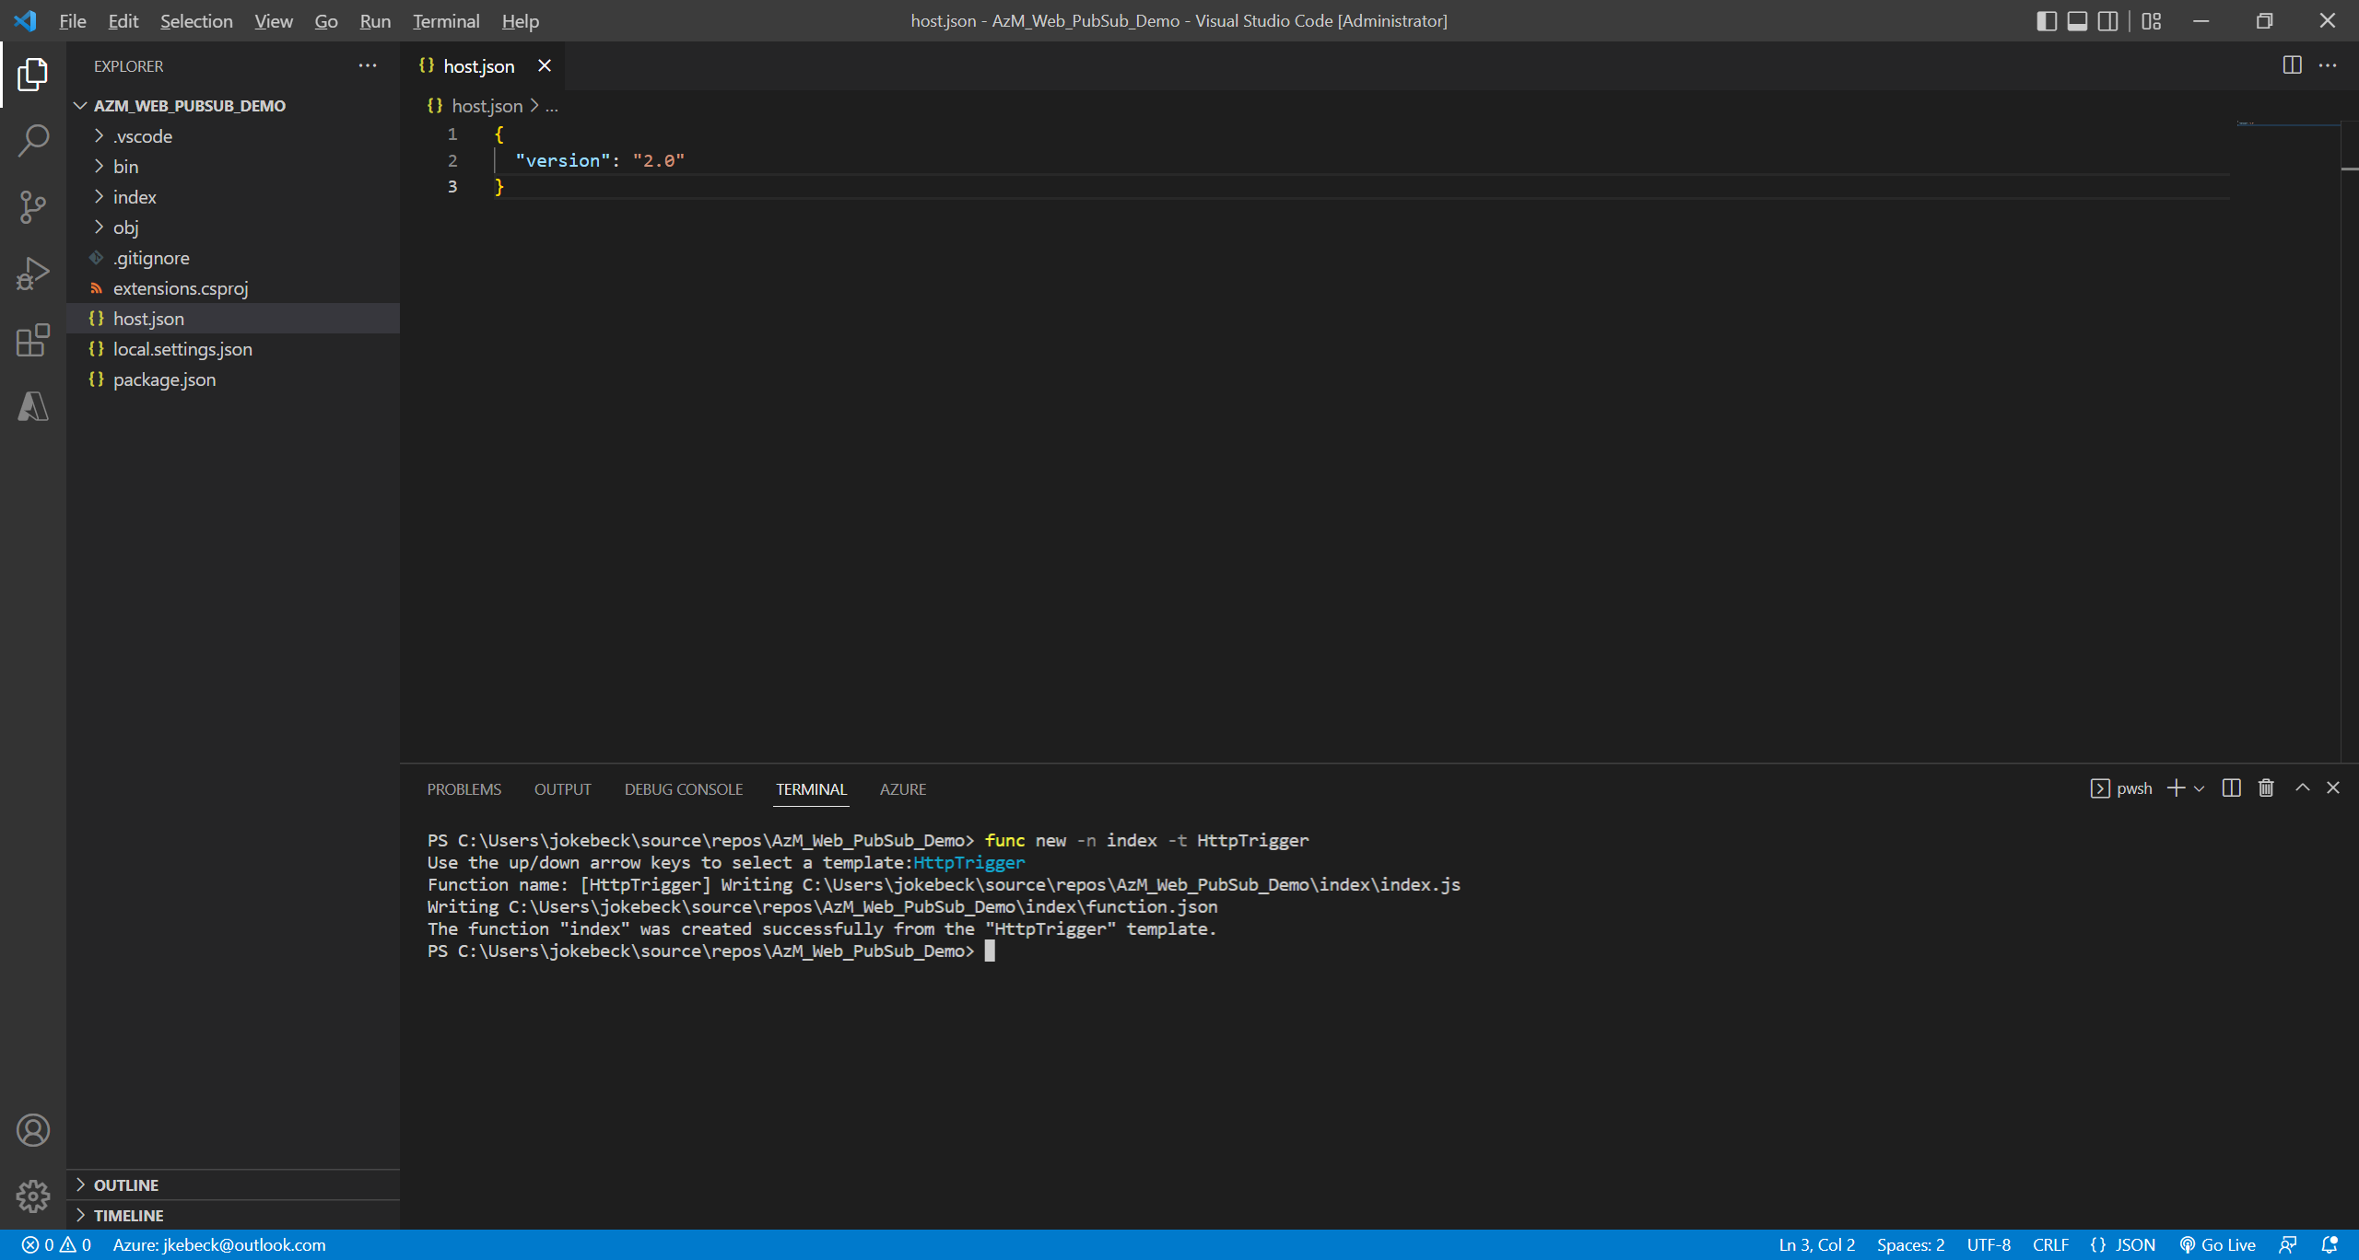
Create an index function to read and host a static web page for clients. func new -n index -t HttpTrigger

Slide 40
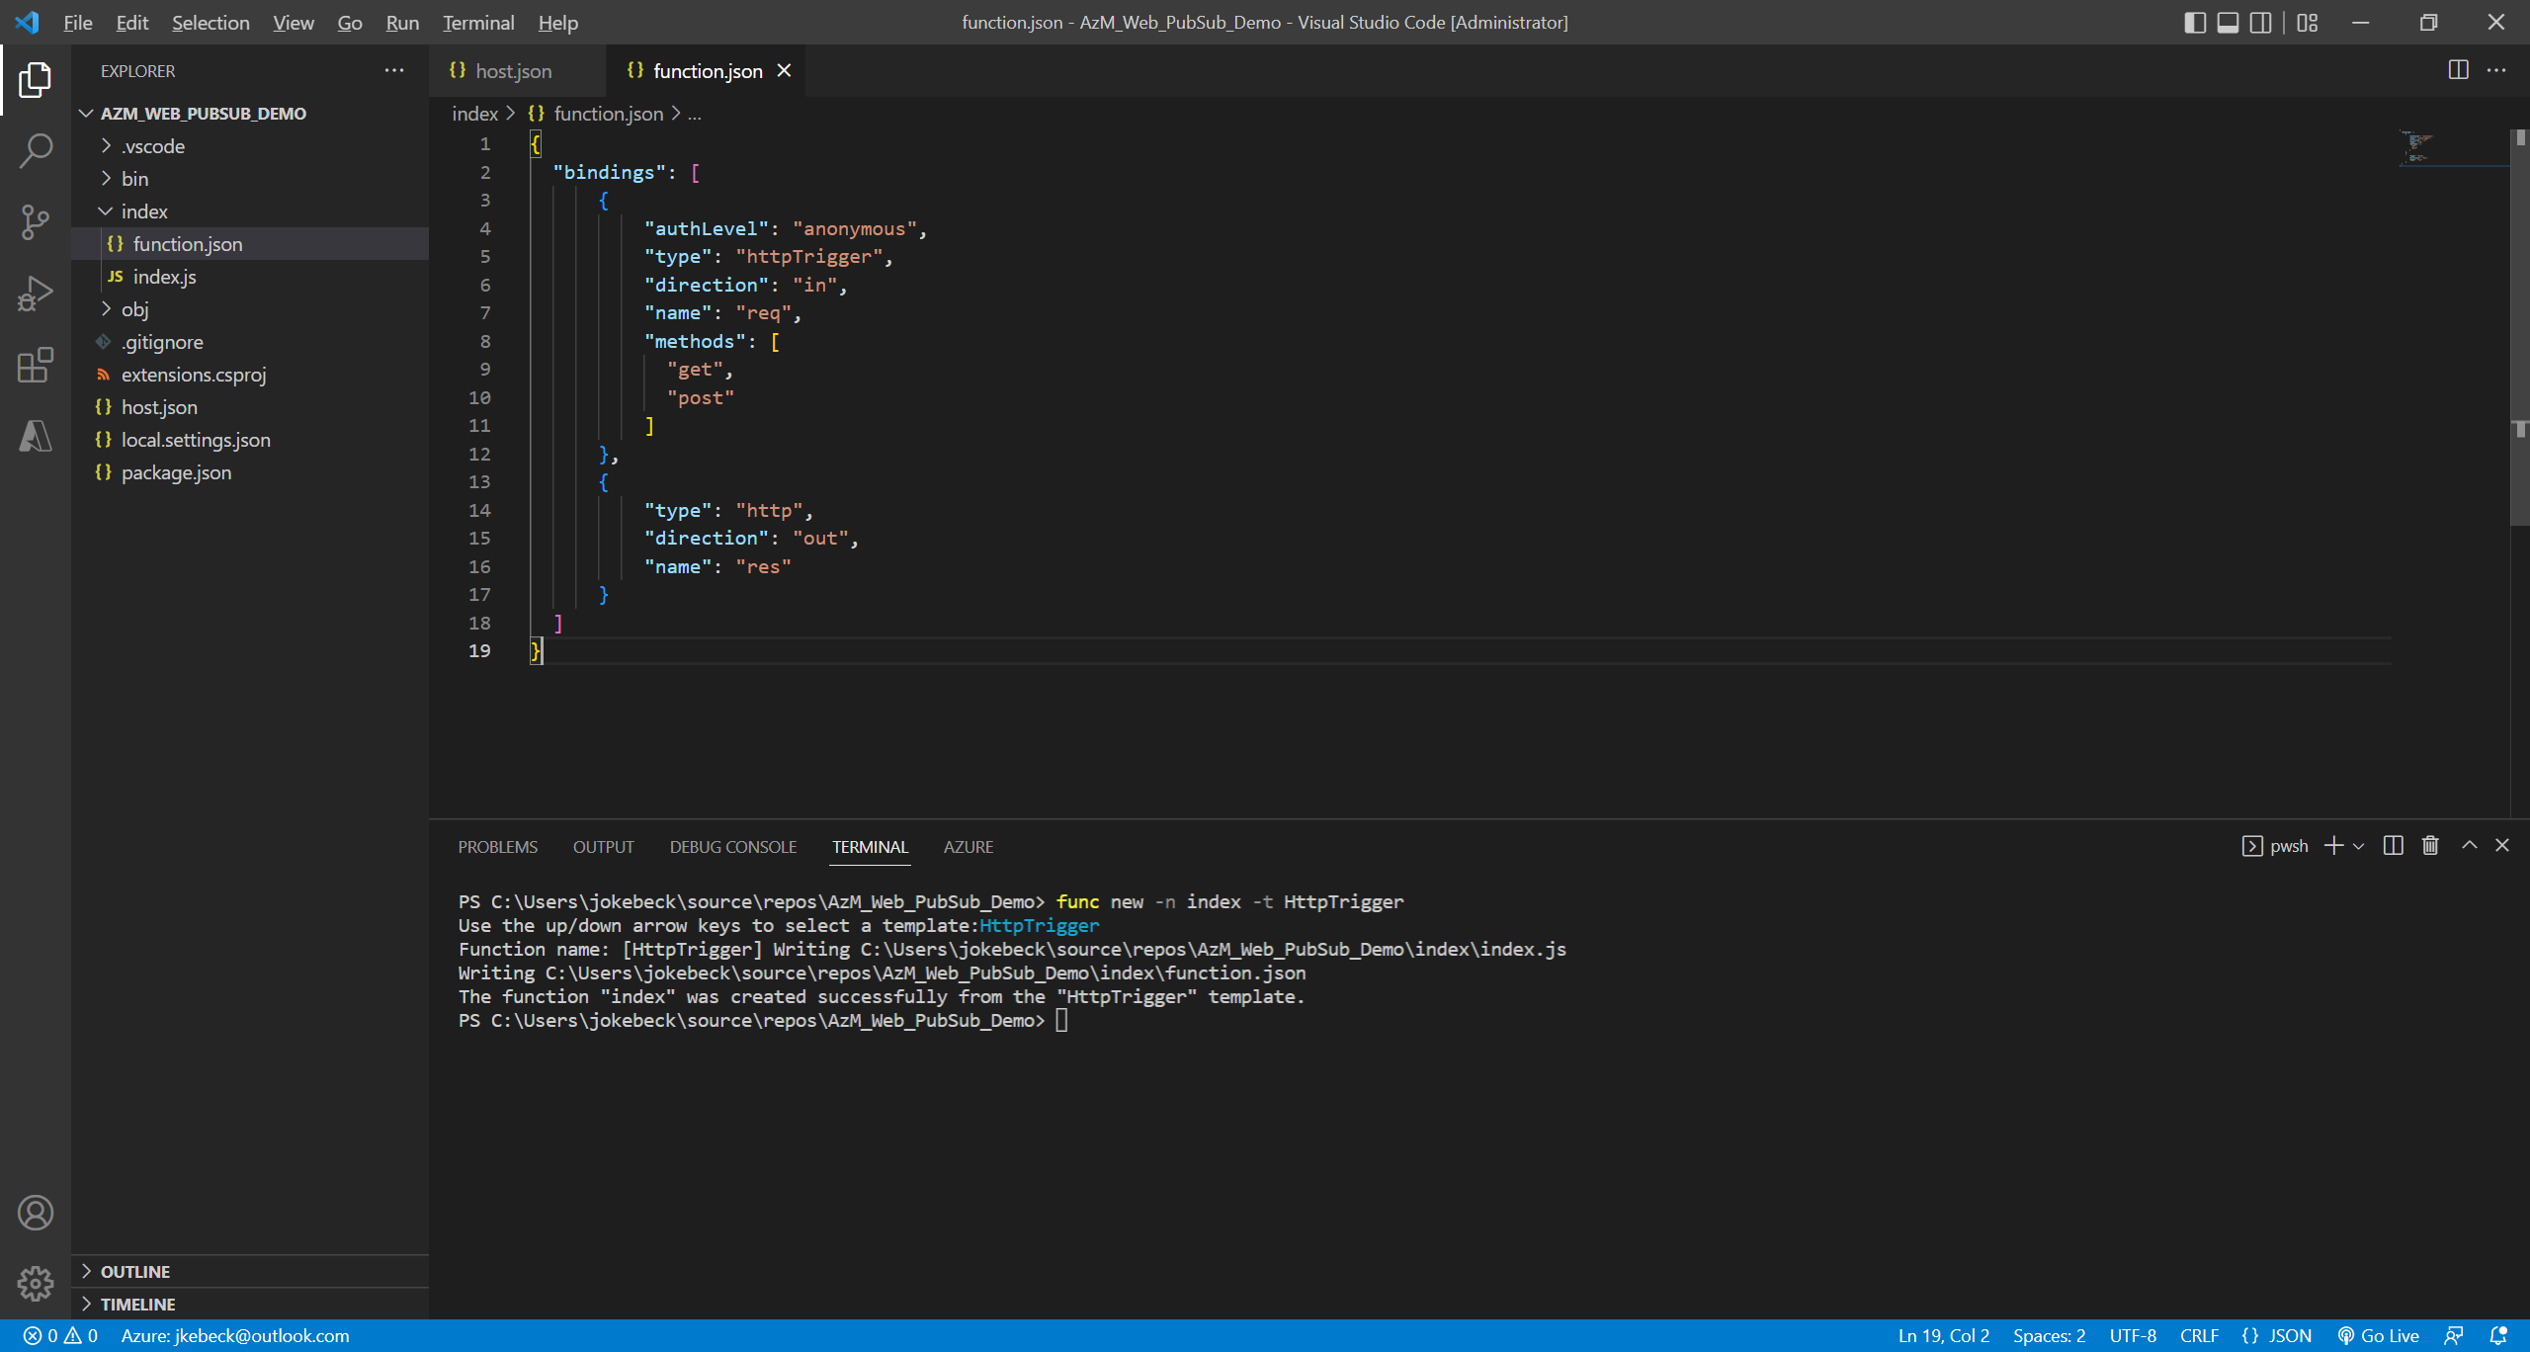
Update index/function.json as follows:
{
"bindings": [
{
"authLevel": "anonymous",
"type": "httpTrigger",
"direction": "in",
"name": "req",
"methods": [
"get",
"post"
]
},
{
"type": "http",
"direction": "out",
"name": "res"
}
]
}

Slide 41
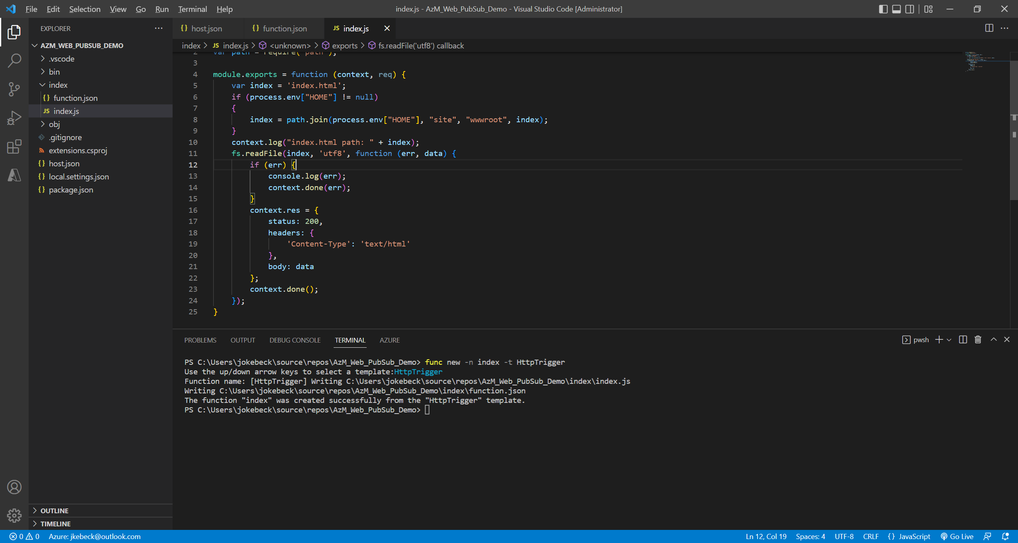
Update index/index.js as follows:
var fs = require('fs');
var path = require('path');
module.exports = function (context, req) {
var index = 'index.html';
if (process.env["HOME"] != null)
{
index = path.join(process.env["HOME"], "site", "wwwroot", index);
}
context.log("index.html path: " + index);
fs.readFile(index, 'utf8', function (err, data) {
if (err) {
console.log(err);
context.done(err);
}
context.res = {
status: 200,
headers: {
'Content-Type': 'text/html'
},
body: data
};
context.done();
});
}

Slide 42
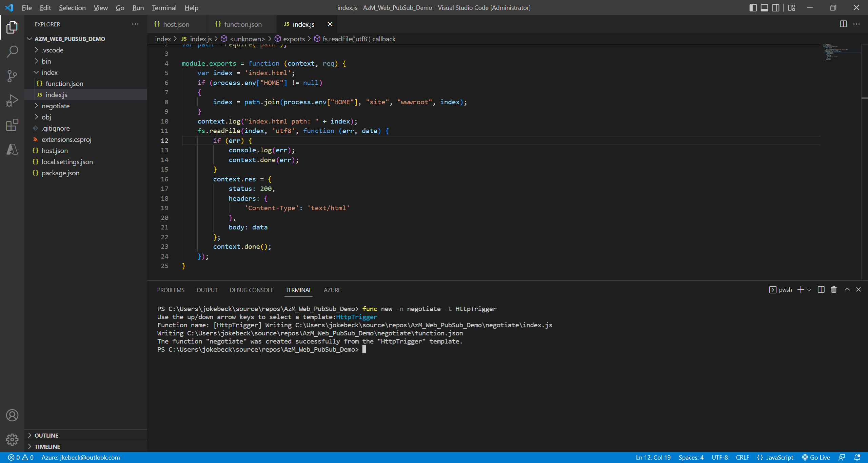
Create a negotiate function to help clients get service connection url with access token. func new -n negotiate -t HttpTrigger

Slide 43
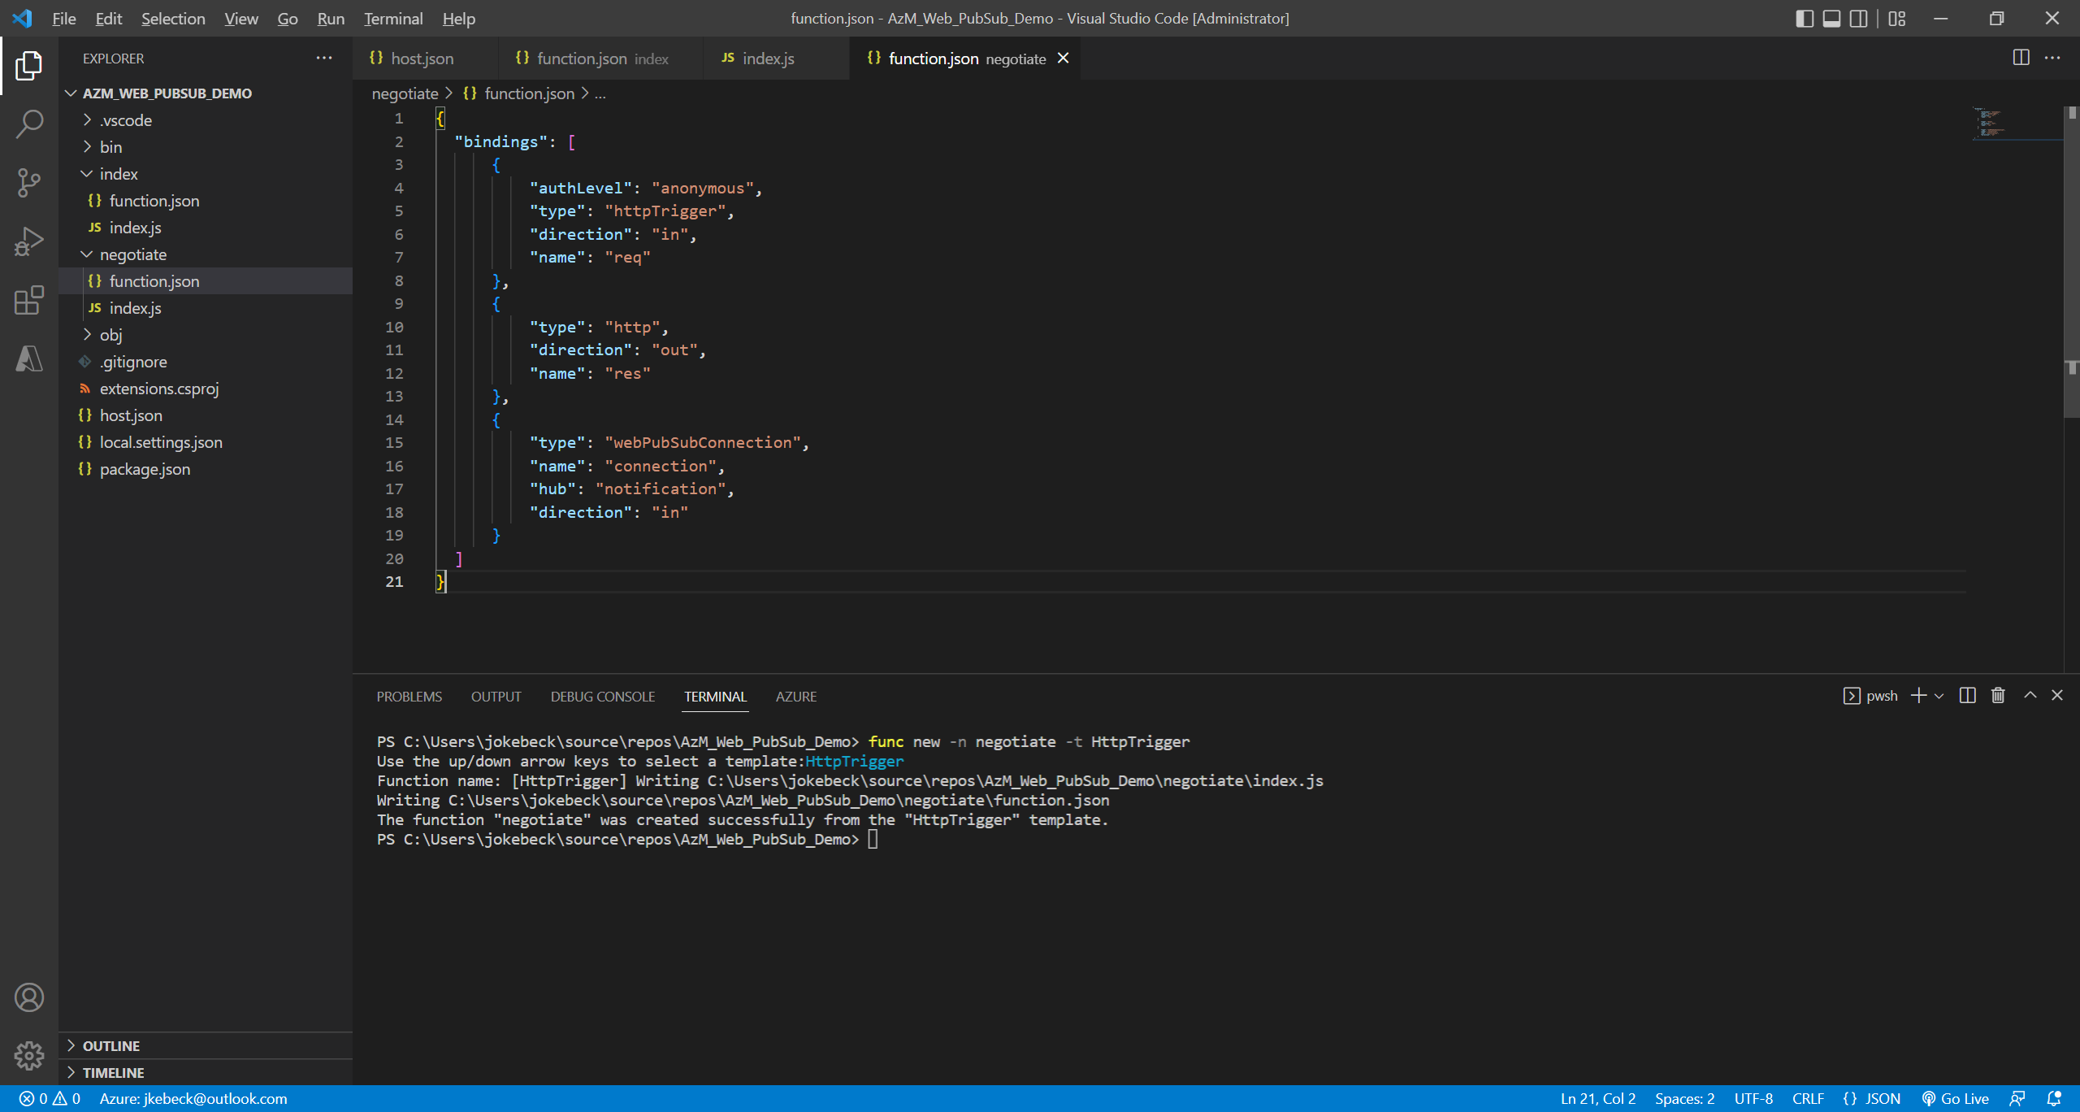
Update negotiate/function.json as follows:
{
"bindings": [
{
"authLevel": "anonymous",
"type": "httpTrigger",
"direction": "in",
"name": "req"
},
{
"type": "http",
"direction": "out",
"name": "res"
},
{
"type": "webPubSubConnection",
"name": "connection",
"hub": "notification",
"direction": "in"
}
]
}

Slide 44
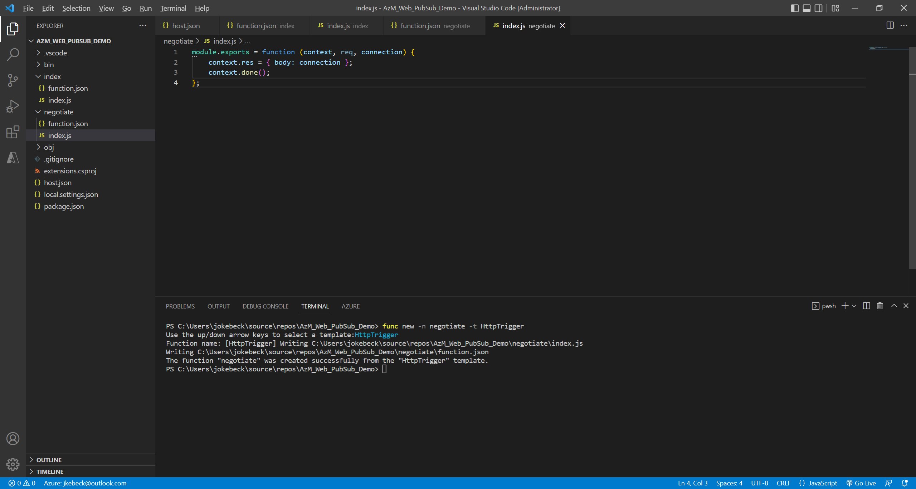
Update negotiate/index.js as follows:
module.exports = function (context, req, connection) {
context.res = { body: connection };
context.done();
};

Slide 45
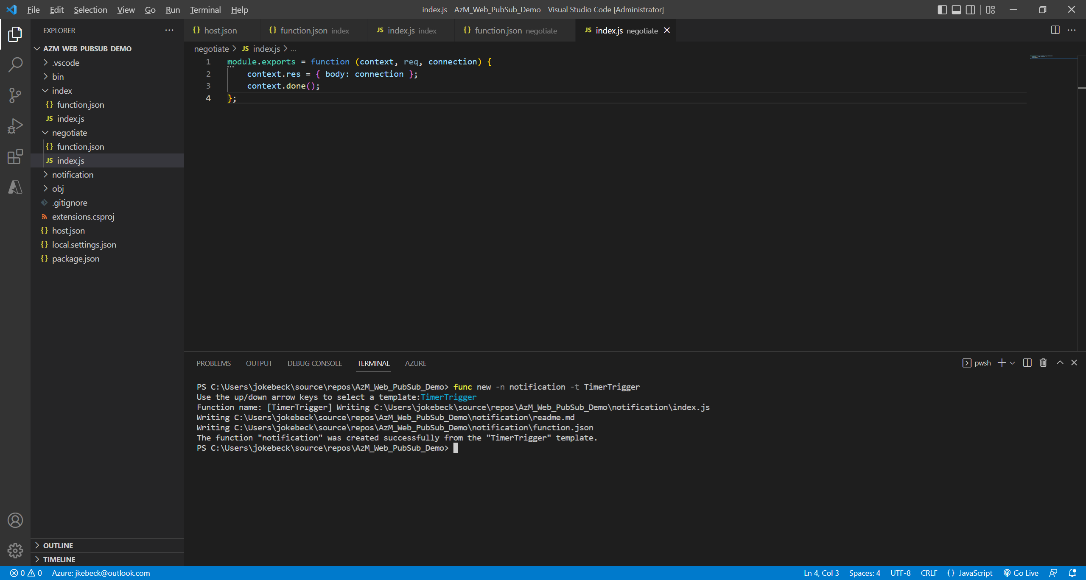
Create a notification function to help clients get service connection url with access token. func new -n notification -t TimerTrigger

Slide 46
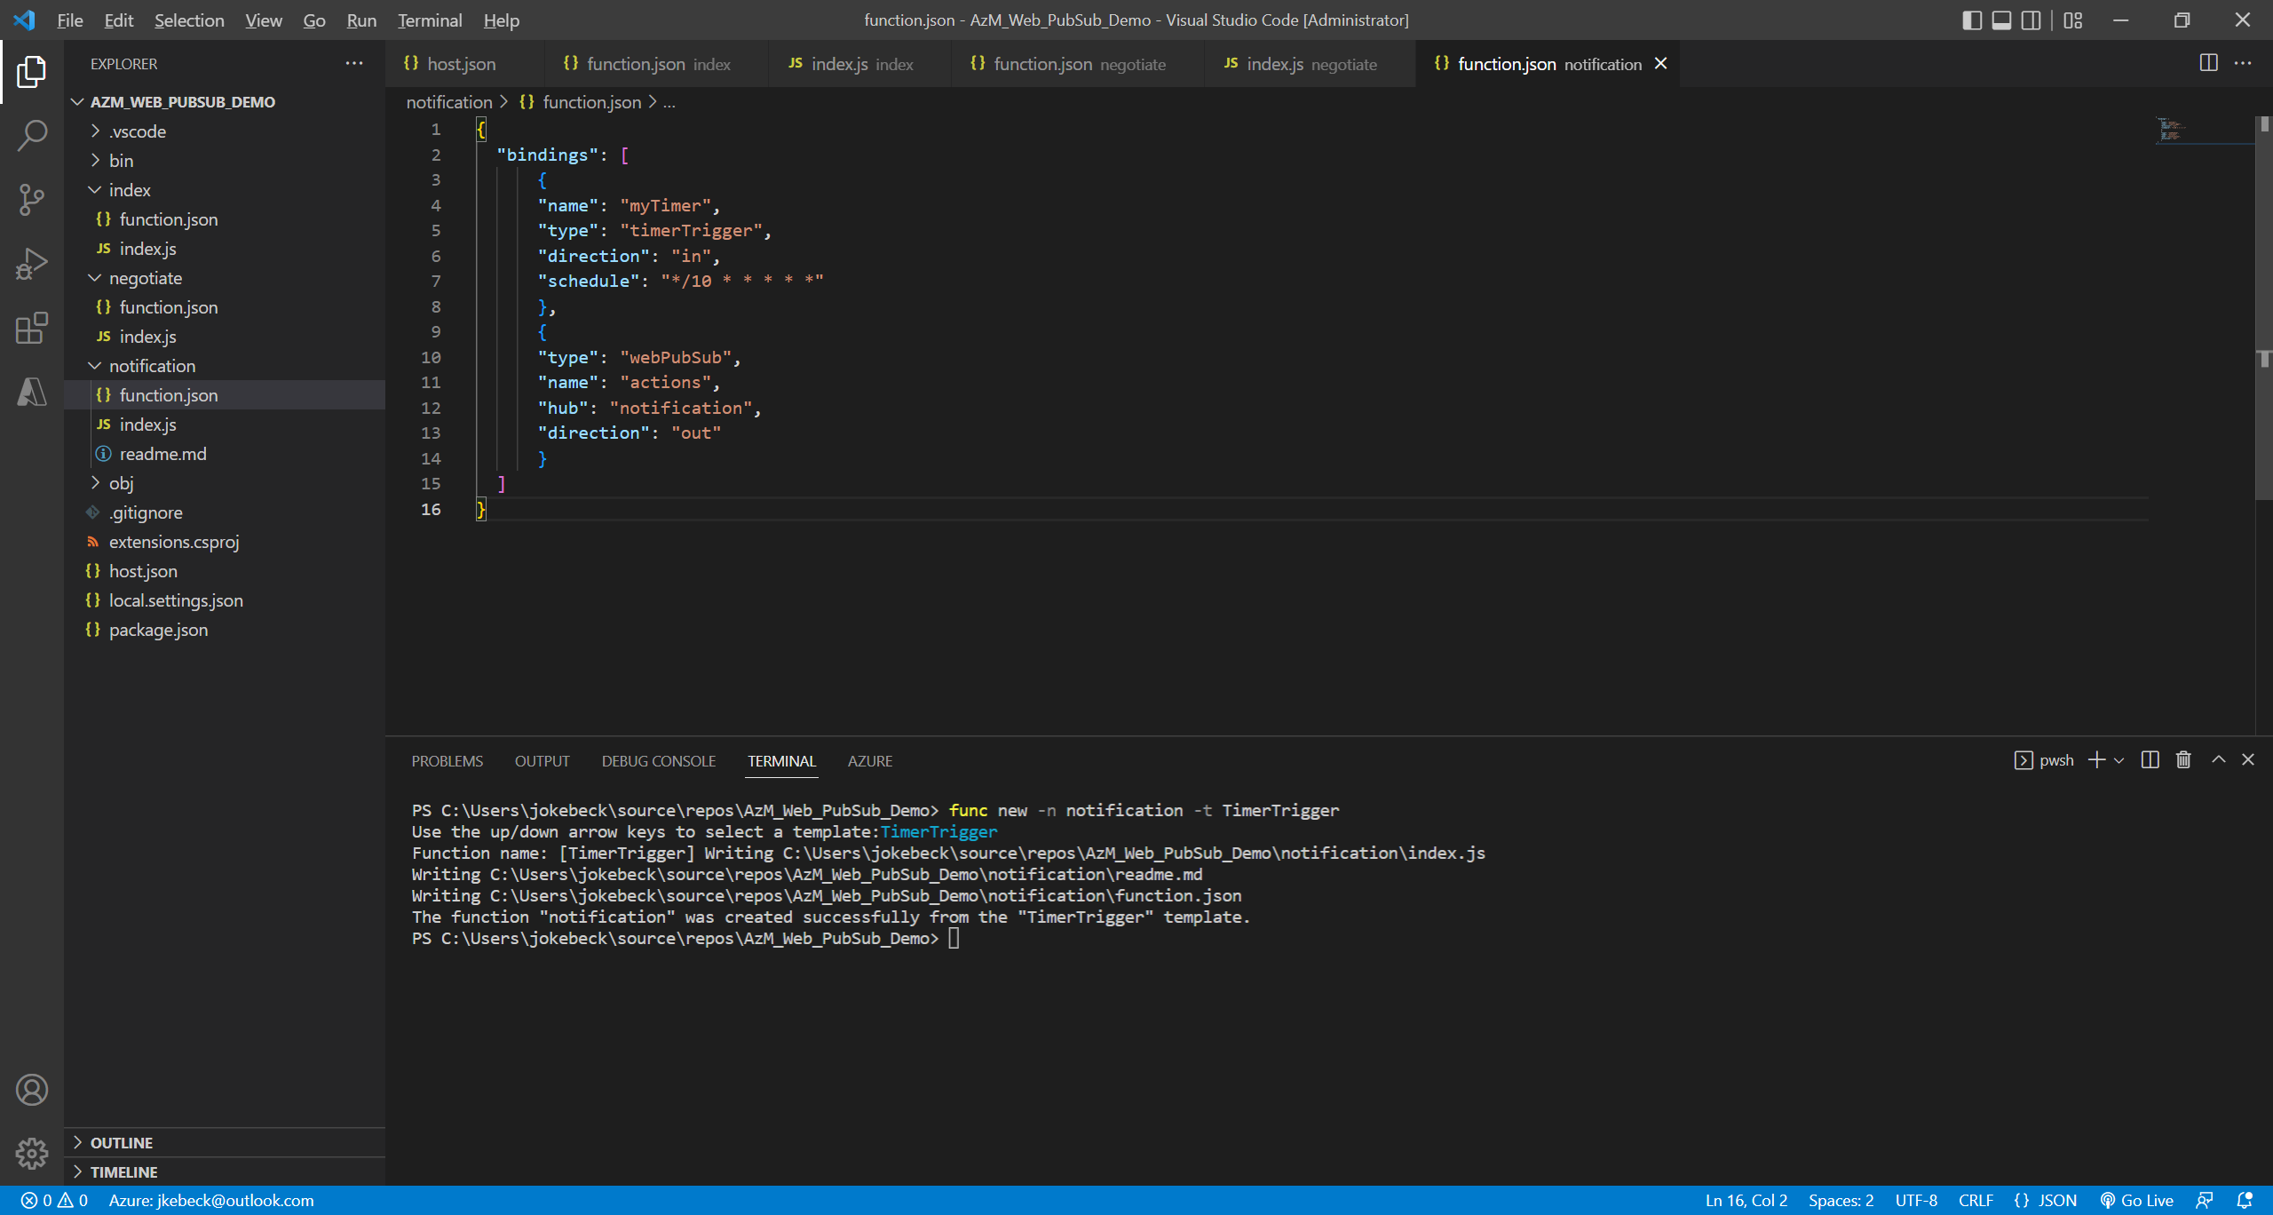
Update notification/function.json as follows:
{
"bindings": [
{
"name": "myTimer",
"type": "timerTrigger",
"direction": "in",
"schedule": "*/10 * * * * *"
},
{
"type": "webPubSub",
"name": "actions",
"hub": "notification",
"direction": "out"
}
]
}

Slide 47
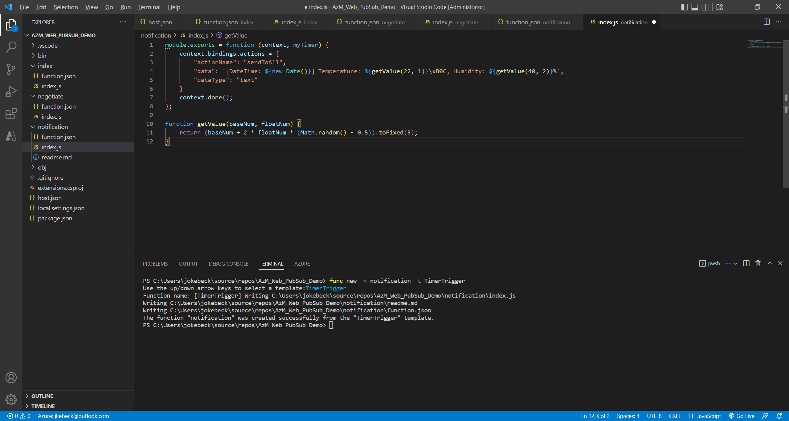
Update notification/index.js as follows:
module.exports = function (context, myTimer) {
context.bindings.actions = {
"actionName": "sendToAll",
"data": `[DateTime: ${new Date()}] Temperature: ${getValue(22, 1)}\xB0C, Humidity: ${getValue(40, 2)}%`,
"dataType": "text"
}
context.done();
};
function getValue(baseNum, floatNum) {
return (baseNum + 2 * floatNum * (Math.random() - 0.5)).toFixed(3);
}

Slide 48
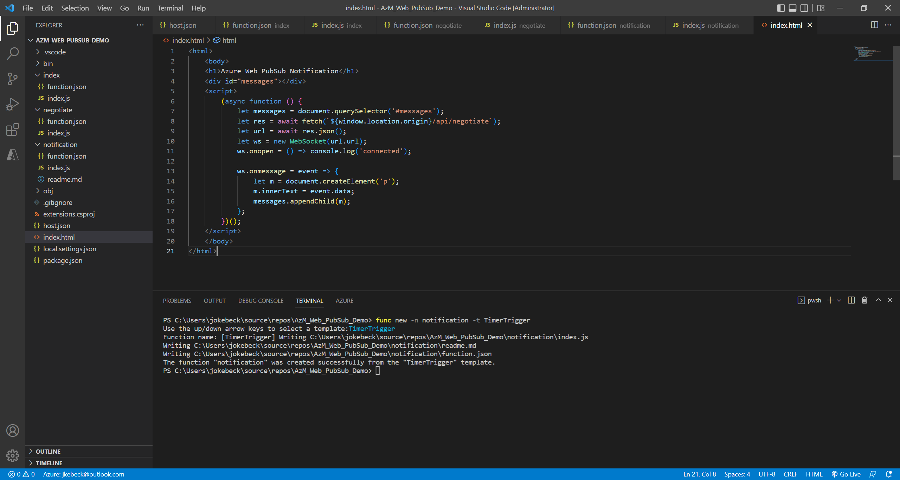

Slide 49
Add the client single page index.html in the project root folder and copy content as below.
<html>
<body>
<h1>Azure Web PubSub Notification</h1>
<div id="messages"></div>
<script>
(async function () {
let messages = document.querySelector('#messages');
let res = await fetch(`${window.location.origin}/api/negotiate`);
let url = await res.json();
let ws = new WebSocket(url.url);
ws.onopen = () => console.log('connected');
ws.onmessage = event => {
let m = document.createElement('p');
m.innerText = event.data;
messages.appendChild(m);
};
})();
</script>
</body>
</html>

Slide 50
Retrieve the connection string for the Azure Web PubSub service from the Azure Portal.

Slide 51
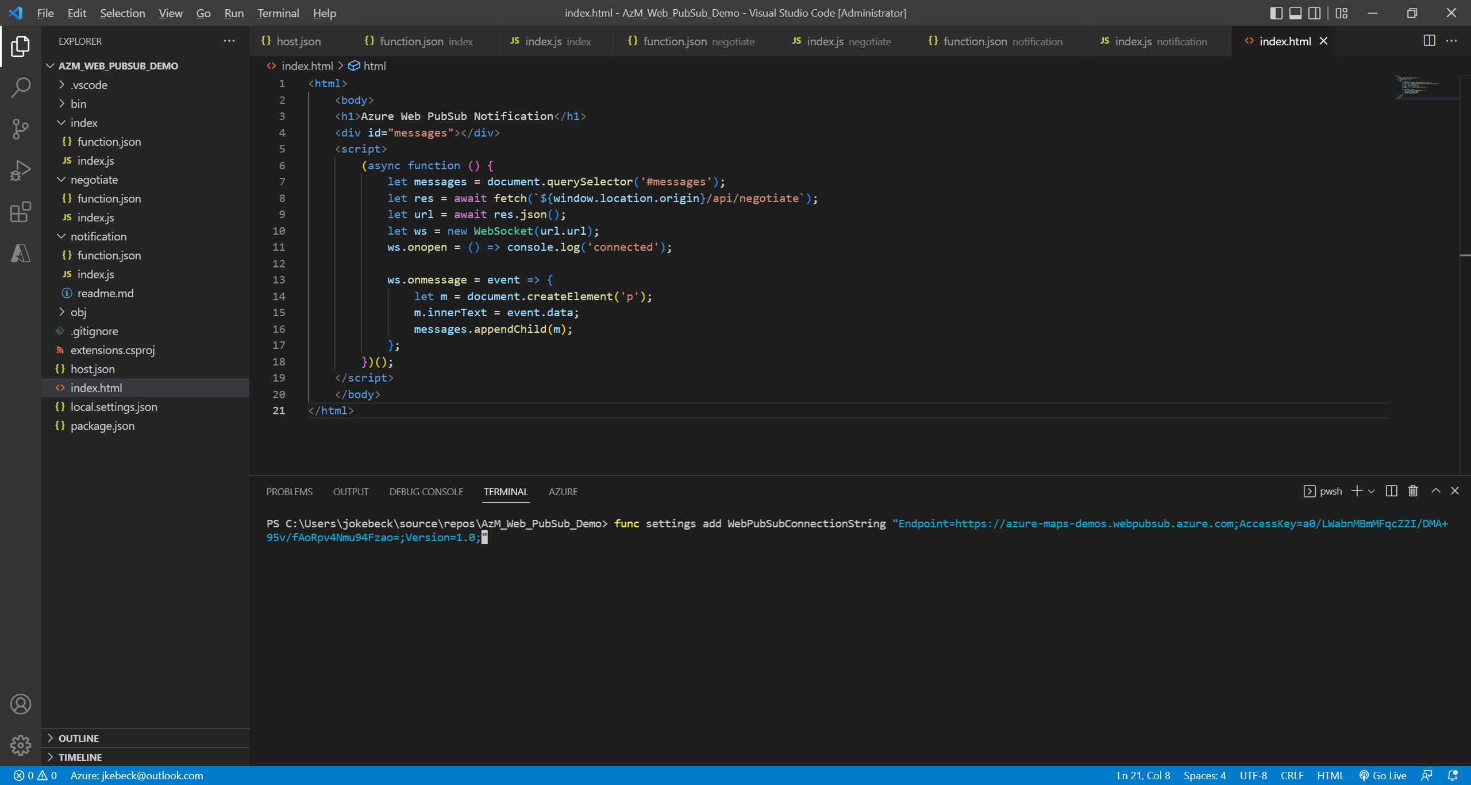
Run the command below to add the Azure Web PubSub connection string to the Azure function.
func settings add WebPubSubConnectionString "<connection-string>"

Slide 52
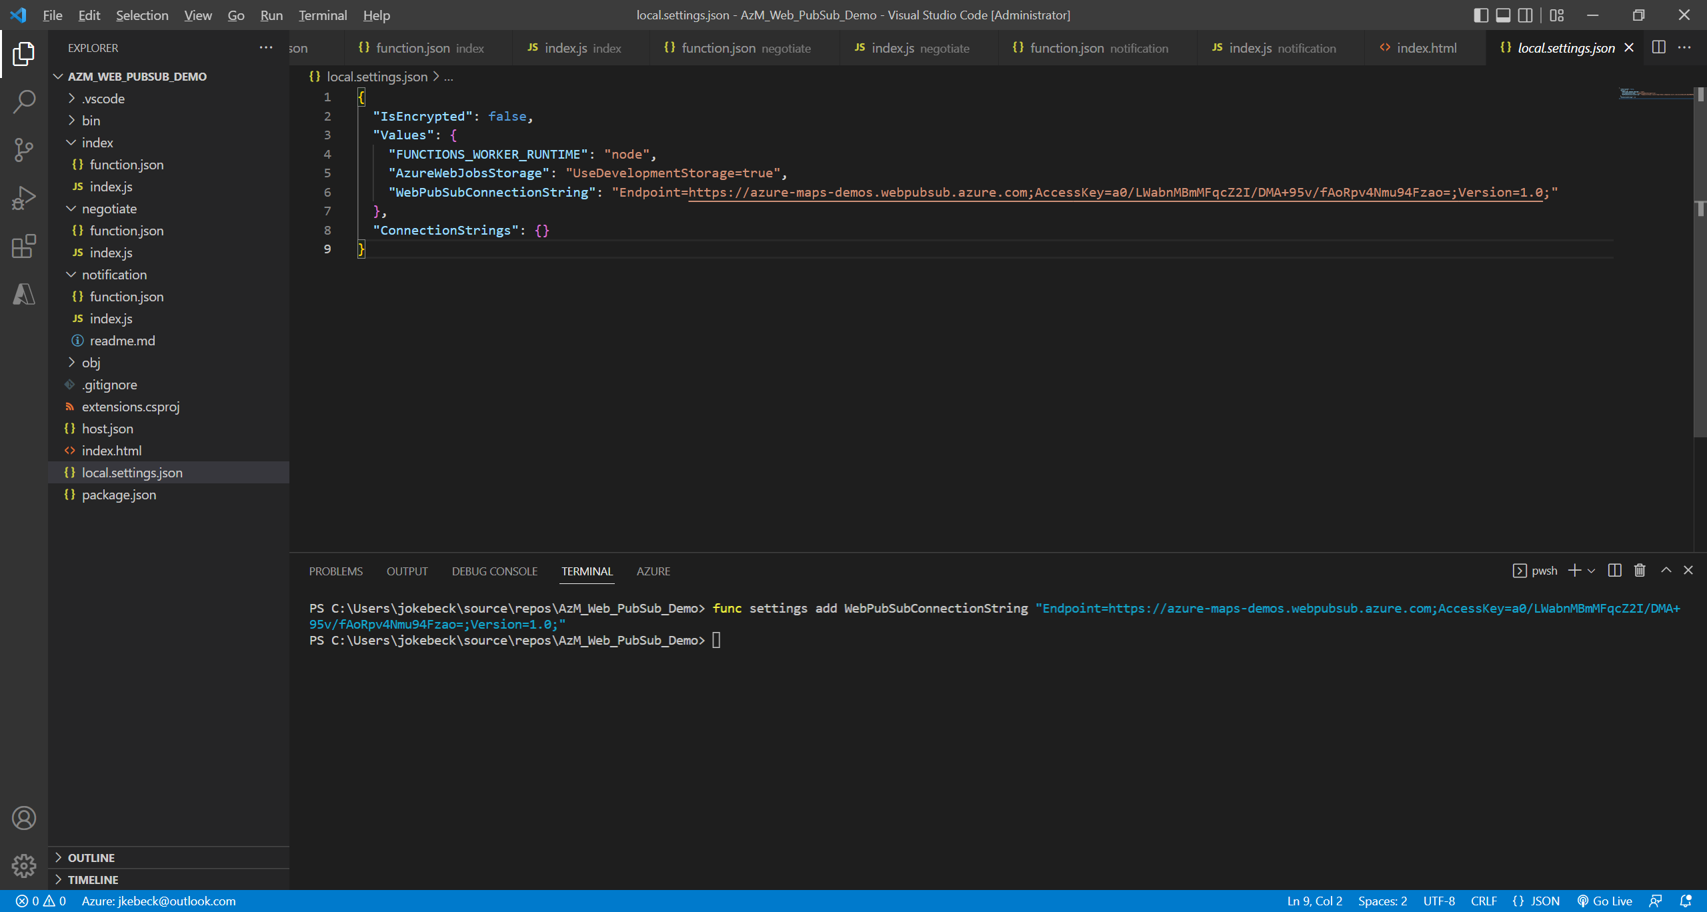
The connection string is added to the local.settings.json.

Slide 53
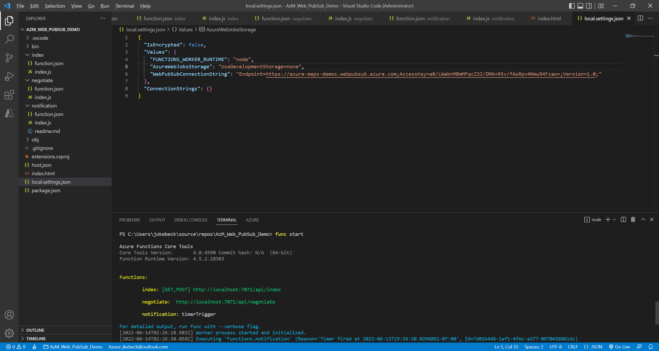
Run the function wit the following command: func start
Open the web page at https://localhost:7071/api/index

Slide 54
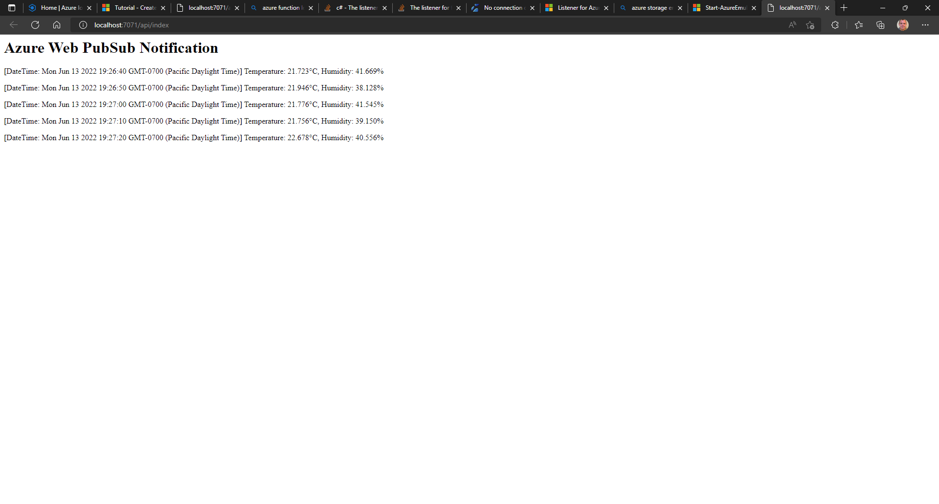
You will see timer-triggered notifications in the browser.

Slide 55
Azure Maps & IoT Central Modify Notification Function

Slide 56
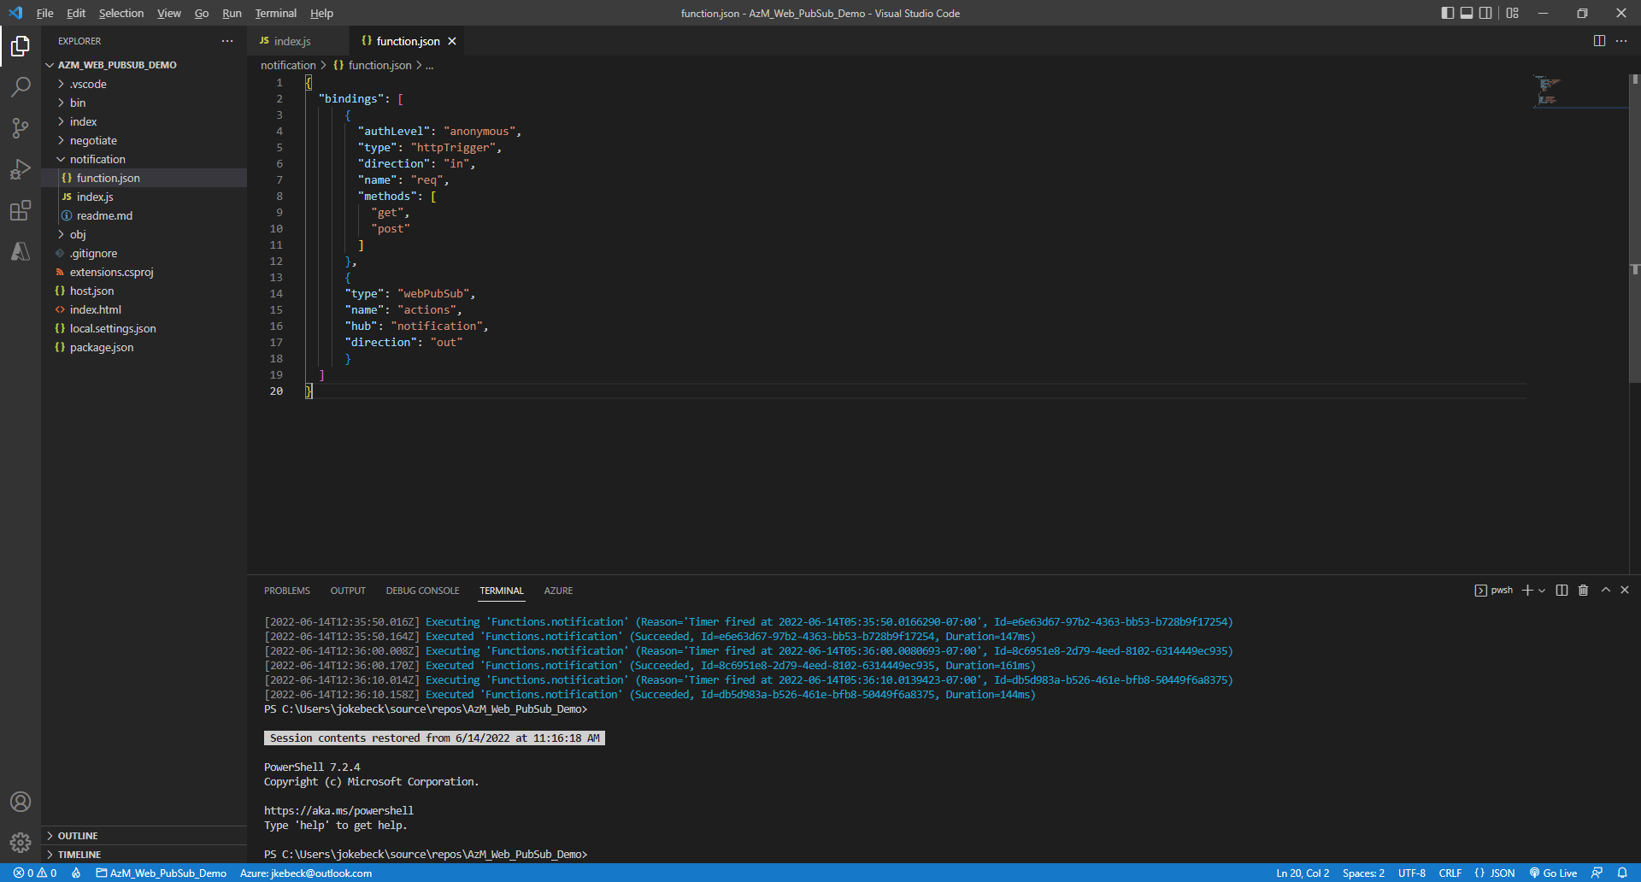
Modify notification/function.js to replace the timerTrigger with an httpTrigger. You will invoke this trigger through a WebHook from IoT Central.
{
"bindings": [
{
"authLevel": "anonymous",
"type": "httpTrigger",
"direction": "in",
"name": "req",
"methods": [
"get",
"post"
]
},
{
"type": "webPubSub",
"name": "actions",
"hub": "notification",
"direction": "out"
}
]
}
You will see timer-triggered notifications in the browser.

Slide 57
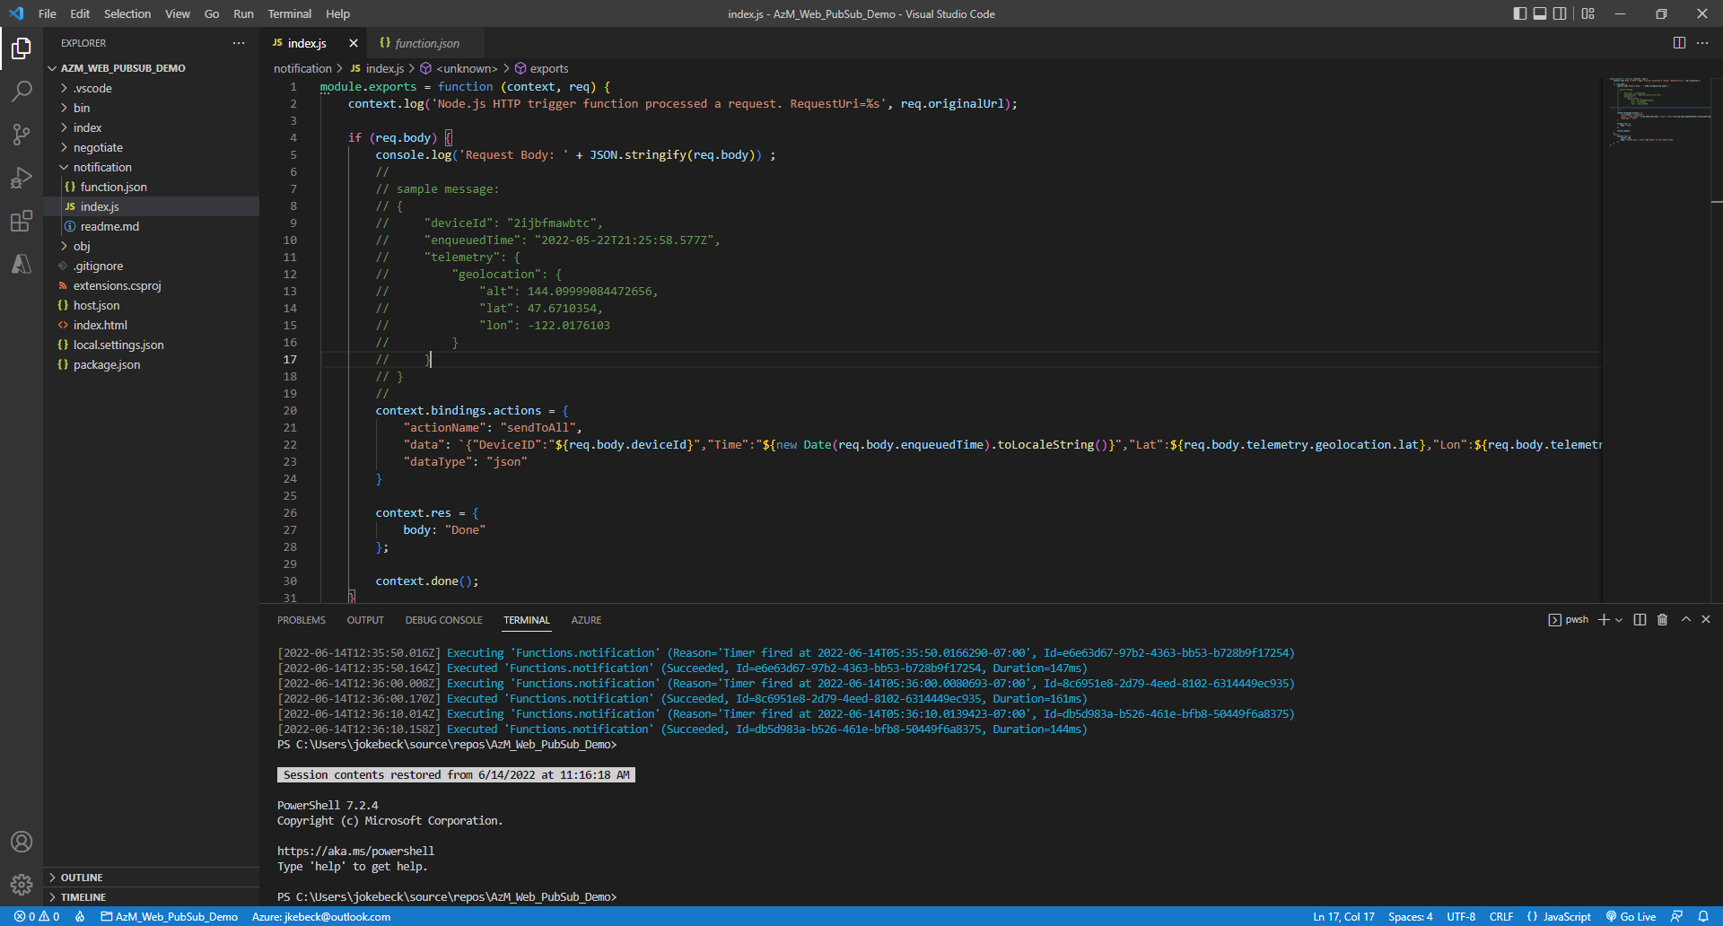
Modify notification/index.js to process a message received from IoT Central and send it to Azure We PubSub:
module.exports = function (context, req) {
context.log('Node.js HTTP trigger function processed a request. RequestUri=%s', req.originalUrl);
if (req.body) {
console.log('Request Body: ' + JSON.stringify(req.body)) ;
context.bindings.actions = {
"actionName": "sendToAll",
"data": `{"DeviceID":"${req.body.deviceId}","Time":"${new Date(req.body.enqueuedTime).toLocaleString()}","Lat":${req.body.telemetry.geolocation.lat},"Lon":${req.body.telemetry.geolocation.lon}}`,
"dataType": "json"
}
context.res = {
body: "Done"
};
context.done();
}
else {
context.res = {
status: 400,
body: "Please pass a valid JSON object in the request body"
};
}
};

Slide 58
Azure Maps & IoT Central Create Azure Maps Account

Slide 59
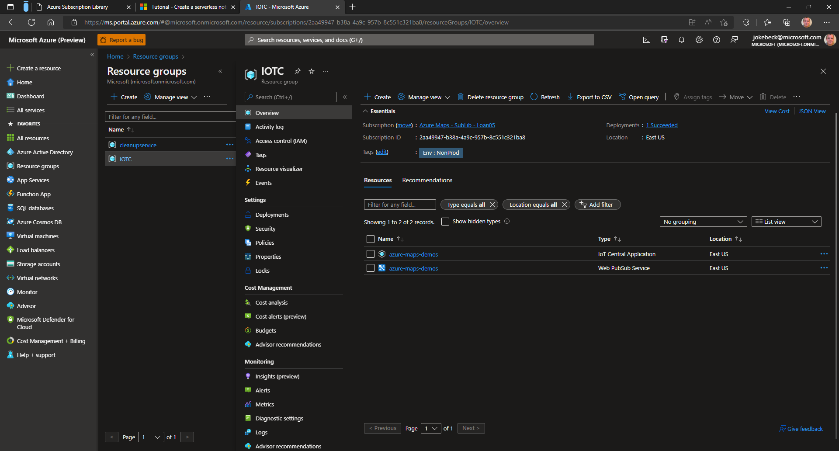
In the Azure Portal navigate to the resource group with IoT Central and the Azure Web PubSub service.
Click on [Create] to create a new resource

Slide 60

Search for Azure Maps

Slide 61

Click on [Create]

Slide 62

Give the resource a name.
Pick the same region as you have for the other services.
Use the Gen 2 pricing tier
Tick the box to acknowledge the license agreement
Click [Review + create]

Slide 63

Click [Create]

Slide 64

Once the deployment is complete…

Slide 65

…navigate to the resource…

Slide 66

…and enable CORS.

Slide 67
Azure Maps & IoT Central Modify Web Page in Azure Function

Slide 68

In VS Code replace the code of the webpage served by the Azure Function (index.html) with the code below.
In index.html replace the placeholder “Your Azure Maps Key” with the primary key for your Azure Maps account
Notes:
<html>
<head>
<title>Azure Maps Web PubSub</title>
<link rel="shortcut icon" href="https://donkeyiotfuncstg.blob.core.windows.net/public/favicon.ico"/>
<meta charset="utf-8">
<meta http-equiv="x-ua-compatible" content="IE=Edge">
<meta name="viewport" content="width=device-width, initial-scale=1, shrink-to-fit=no">
<!-- Load the JavaScript and CSS files for the Azure Maps Web SDK. -->
<link rel="stylesheet" href="https://atlas.microsoft.com/sdk/javascript/mapcontrol/2/atlas.min.css" type="text/css">
<script src="https://atlas.microsoft.com/sdk/javascript/mapcontrol/2/atlas.min.js"></script>
<!-- Load the JavaScript and CSS files that has our custom control. -->
<link rel="stylesheet" href="https://donkeyiotfuncstg.blob.core.windows.net/public/azure-maps-layer-legend.min.css" type="text/css" />
<script src="https://donkeyiotfuncstg.blob.core.windows.net/public/azure-maps-layer-legend.min.js"></script>
<style>
html, body {
margin: 0;
}
#myMap {
height: 100vh;
width: 100vw;
}
td {
font-family: Arial;
font-size: 12px;
}
.controlContainer {
position: absolute;
top: 10px;
left: 50%;
transform: translateX(-50%);
background-color: #fff;
}
.navText {
margin: 2px;
background-color: #fff;
box-shadow: rgb(0 0 0 / 16%) 0 0 4px;
border: 1px solid grey;
border-radius: 2px;
width: 100px;
height: 32px;
padding: 2px 8px;
color: black;
font-family: Arial;
font-size: 12px;
font-weight: bold;
text-align: center;
text-decoration: none;
line-height: 20px;
}
.navButton {
margin: 2px;
background-color: #fff;
box-shadow: rgb(0 0 0 / 16%) 0 0 4px;
border: 1px solid grey;
border-radius: 2px;
width: 100px;
height: 32px;
padding: 2px 8px;
color: black;
font-size: 12px;
font-weight: bold;
text-align: center;
text-decoration: none;
line-height: 20px;
display: inline-block;
cursor: pointer;
}
.navButton:hover {
color: deepskyblue;
}
</style>
</head>
<body onload="InitMap()">
<div id="myMap"></div>
<div class="controlContainer">
<table>
<tr>
<td>Enter Device ID</td><td>
<input class="navText" type="text" id="txtDevice">
</td>
<td>
<button class="navButton" onclick="findDevice()" title="Find Device">Find Device</button>
</td>
<td>
<button class="navButton" onclick="loadHistory()" title="Load History">Load History</button>
</td>
</tr>
</table>
</div>
<script>
//
// Begin Edits
//
var mapKey = ‘YOUR_AZURE_MAPS_KEY';
var urlHistory = 'https://donkeyiotfuncstg.blob.core.windows.net/public/lochistory.json';
//
// End Edits
//
var map;
var popup = null;
var dsHeatmap = new atlas.source.DataSource();
var lHeatmap = null;
var dsLastLoc = new atlas.source.DataSource();
var lLastLoc = null;
function InitMap()
{
map = new atlas.Map('myMap', {
center: [-122.33, 47.6],
zoom: 12,
language: 'en-US',
renderWorldCopies: false,
showBuildingModels: true,
showLogo: true,
showFeedbackLink: false,
style: 'grayscale_dark',
authOptions: {
authType: 'subscriptionKey',
subscriptionKey: mapKey
}
});
//Wait until the map resources are ready.
map.events.add('ready', function () {
// add map navigation and style controls
map.controls.add([
new atlas.control.ZoomControl(),
new atlas.control.CompassControl(),
new atlas.control.PitchControl(),
new atlas.control.StyleControl({
mapStyles: ["road", "grayscale_light", "grayscale_dark", "night", "satellite", "satellite_road_labels"]
})
], {
position: "top-right"
});
// Create the layer control.
layerControl = new atlas.control.LayerControl({
// layout of the control (accordion, list or carousel)
layout: 'list',
// Set dynamic layer group settings.
dynamicLayerGroup: {
groupTitle: 'Layers',
layout: 'checkbox'
},
layerGroups: [
{
layout: 'range',
groupTitle: 'Heatmap Intensity',
layers: ['Heatmap'],
items: [{
label: '{rangeValue}',
value: 1,
min: 0,
max: 5,
step:0.02,
style: {
intensity: '{rangeValue}'
},
updateOnInput: true
}]
},
{
layout: 'range',
groupTitle: 'Heatmap Radius',
layers: ['Heatmap'],
items: [{
label: '{rangeValue}',
value: 10,
min: 1,
max: 100,
step:1,
style: {
radius: '{rangeValue}'
},
updateOnInput: true
}]
}]
});
// Add the layer control to the map.
map.controls.add(layerControl, {
position: 'top-left'
});
// Add a Heatmap datasource and layer
map.sources.add(dsHeatmap);
lHeatmap = new atlas.layer.HeatMapLayer(dsHeatmap, 'Heatmap', {
radius: 10,
opacity: 0.8
});
map.layers.add(lHeatmap, 'labels');
// Add a Bubble datasource and layer
map.sources.add(dsLastLoc);
lLastLoc = new atlas.layer.BubbleLayer(dsLastLoc, 'Last Location', {
radius: 5,
strokeColor: "#4288f7",
strokeWidth: 1,
color: "#4288f7",
visible: false
});
map.layers.add(lLastLoc);
// Create a popup but leave it closed so we can update it and display it later.
popup = new atlas.Popup();
// Add a click event to the layer.
map.events.add('click', lLastLoc, showPopup);
// Add an Image Layer
map.layers.add(new atlas.layer.ImageLayer({
url: 'https://donkeyiotfuncstg.blob.core.windows.net/public/Zoo_Map.png',
coordinates: [
[-122.354820874, 47.672017926], //Top Left Corner
[-122.347396551, 47.672017926], //Top Right Corner
[-122.347396551, 47.664543535], //Bottom Right Corner
[-122.354820874, 47.664543535] //Bottom Left Corner
],
minZoom: 15,
maxZoom: 20,
visible: false
}, 'Image Layer'));
// Add a tile layer
map.layers.add(new atlas.layer.TileLayer({
tileUrl: 'https://donkeyiotfuncstg.blob.core.windows.net/public/Woodland_Park_Zoo/{z}/{x}/{y}.png',
opacity: 1,
tileSize: 256,
minSourceZoom: 15,
maxSourceZoom: 20,
bound: [-122.354820874, 47.664543535, -122.347396551, 47.672017926], //West, South, East, North
visible: false
}, 'Tile Layer'), null);
// Connect to Azure Web PubSub
(async function () {
let res = await fetch(`${window.location.origin}/api/negotiate`);
let url = await res.json();
let ws = new WebSocket(url.url);
ws.onopen = () => console.log('connected');
ws.onmessage = event => {
var msg = JSON.parse(event.data);
console.log("Telemetry update for Device ID: " + msg.DeviceID + ", Lat: " + msg.Lat + ", Lon: " + msg.Lon);
dsHeatmap.add(new atlas.data.Point([msg.Lon, msg.Lat]));
try{
dsLastLoc.getShapeById(msg.DeviceID).setCoordinates([msg.Lon, msg.Lat]);
}
catch(err){
dsLastLoc.add( new atlas.data.Feature(new atlas.data.Point([msg.Lon, msg.Lat]), {
title: 'Devide ID: ' + msg.DeviceID,
description: 'Lat: ' + msg.Lat + '<br>Lon: ' + msg.Lon
}, msg.DeviceID));
}
};
})();
});
}
function showPopup(e) {
if (e.shapes && e.shapes.length > 0) {
var properties = e.shapes[0].getProperties();
popup.setOptions({
//Update the content of the popup.
content: atlas.PopupTemplate.applyTemplate(properties, properties.popupTemplate),
//Update the position of the popup with the pins coordinate.
position: e.shapes[0].getCoordinates()
});
//Open the popup.
popup.open(map);
}
}
function loadHistory(){
dsHeatmap.importDataFromUrl(urlHistory);
}
function findDevice(){
try{
var device = dsLastLoc.getShapeById(document.getElementById("txtDevice").value);
console.log("Searching for Device ID: " + device);
var properties = device.getProperties()
popup.setOptions({
//Update the content of the popup.
content: atlas.PopupTemplate.applyTemplate(properties, properties.popupTemplate),
//Update the position of the popup with the pins coordinate.
position: device.getCoordinates()
});
// Make the layer for the last loc visible
var options = lLastLoc.getOptions();
options.visible = true;
lLastLoc.setOptions(options);
// Set the map view and open the popup.
map.setCamera({
center: device.getCoordinates()
});
popup.open(map);
}
catch(err){
alert("Device ID " + device + " not found");
}
}
</script>
</body>
</html>

Slide 69

Run the function locally func start

Slide 70

Navigate to the webpage (index.html)
This sample page show-cases a few features of the Azure Maps Web SDK. Standalone examples can we found in Azure Maps Samples, incl.:
Heat Map
Layer Control
Image Layer
Tile Layer

Slide 71

Open Postman and craft a message that mimics telemetry data coming from IoT Central {
"deviceId": "DonkeyPhone",
"enqueuedTime": "2022-06-14T21:25:58.577Z",
"telemetry": {
"geolocation": {
"alt": 144.1,
"lat": 47.614953,
"lon": -122.194170
}
}
}

Slide 72

You see the first heat-point on the map.

Slide 73
Azure Maps & IoT Central Deploy Function App

Slide 74

Navigate to the Azure Portal and there to your resource groups with the 3 resources you have created thus far.
Click on [Create].

Slide 75


Search for [Function App]

Slide 76

Click on [Create]

Slide 77

Provide a name
Select Node.js as the runtime
Pick the same region where you have also deployed the previous resources.
Use Linux as the operating system and scroll further down…

Slide 78

…to pick [Consumption (Serverless)] as the pricing plan.
Click [Next : Hosting]

Slide 79

Click [Create new]…

Slide 80

…and provide a name to create a new Storage Account for the Function app.
Click [OK]
Click [Next : Networking]

Slide 81

Click [Next : Monitoring]

Slide 82

Select [Yes] to enable Application Insights
Click [Review and Create]

Slide 83

Click [Create]

Slide 84

After the deployment is complete go to the resource group…

Slide 85

You will find a few new resources related to you Function app
Application Insights
A Storage Account
An App Service Plan
And the Function app itself

Slide 86
In VS Code open a terminal to log into Azure
Enter az login
You will be prompted to log into your Azure account using a browser

Slide 87
If you have multiple subscriptions that you have access to with the same account enter az account set --subscription “YOUR SUBSCRIPTION ID"
Notes:
az account set --subscription "2aa49947-b38a-4a9c-957b-8c551c321ba8"

Slide 88
Publish the function func azure functionapp publish [YOUR FUNCTION APP NAME] --publish-local-settings
Notes:
func azure functionapp publish azure-maps-demos --publish-local-settings

Slide 89

Do not overwrite the storage account settings in the cloud.
If you want to avoid that prompt…

Slide 90
Copy the connection string for the Storage Account from the Azure Portal…

Slide 91

…and paste it in the local.settings.json of your Function app.

Slide 92

Open the URL of your index Function.

Slide 93

In Postman send the message again but this time pick the public URL of your Function app.

Slide 94
Verify that a heat-point appears on the map.

Slide 95
Azure Maps & IoT Central Export Data from IoT Central

Slide 96

In IoT Central navigate to Data Export
Click on [New Export].

Slide 97

Give the Export a Name.
Select Telemetry as type of data to export.
Click [+ Filter].

Slide 98

For the purpose of this demo we are only interested in the location data. Select [Sensors / Location / Latitude] as the name…
…and [Exists] as the Operator.
Under Destination click [create a new one’

Slide 99

In the dialog give the destination a name (here: Azure Function)
As Destination type select [Webhook].
In the callback URL provide the URL to your Azure Function notification.
Click on [Create].

Slide 100

Click [+ Transform].

Slide 101

In the left-hand window you can pick the IoT Plug and Play template from the drop-down to review the template that the client uses.

Slide 102

As mentioned previously we are only interested in the location data for the purpose of this demo. The name and value of this telemetry data is shown above.
Apply the following transformation query { deviceId: .device.id, enqueuedTime: .enqueuedTime, telemetry: .telemetry | map({ key: .name, value: .value }) | from_entries, }
Click [Add].

Slide 103

Click [Save].

Slide 104

Once the export status shows [Healthy]…

Slide 105


…open the IoT Plug and Play application on your mobile device and you should see the heat-points show on the map.

Slide 106
Azure Maps & IoT Central Simulating Movement (Data Capture)

Slide 107


It is hard to see movement patterns while you sit in front of your laptop to develop the application. Hence there are 2 applications to capture and replay movement data.
An Android application for your mobile device to capture data in a CSV-file. This app has an integrated map which needs some more work. Provide your Azure Maps subscription key in the MainActivity.kt file.

Slide 108

The app logs your location every 5 seconds and records a CSV-file in the Documents-folder of your device with the following columns:
Date / Time, Latitude, Longitude, Altitude, Bearing and Speed

Slide 109
Azure Maps & IoT Central Simulating Movement (Data Replay)

Slide 110

To replay the data, you can use a .NET Core Console application.

Slide 111

The application requires the following arguments which you can look up for the device you created earlier in IoT Central:
.\IoT-Central-Device-Sim-02.exe “[Device ID]"
“[Primary Key]"
“[ID Scope]"
“[File to Replay]"
[interval in seconds]
Notes:
.\IoT-Central-Device-Sim-02.exe "DonkeyPhone" "IZHRb…” "0ne…" "C:\Users\...\OneDrive\Documents\GeoData\GeoLogs\geolog_220615_081600.csv" 1

Slide 112

When you run the application, you will see the heatmap develop. The 2 sliders in the layer control allow you to influence the intensity of the heatmap.
An additional layer ‘Last Location’ shows the last recorded location for all devices and clicking on the symbol will pop up more detailed information.

Slide 113

The search box allows you to find a specific device and center the map on its location
The [Load History] button will at this time load sample data. We will walk through the process to create your own history in the next step.

Slide 114

Similar there are also tile layers and…

Slide 115

…image overlays implemented that show up from zoom-levels 15 and higher for the Woodland Park Zoo. We will also walk through the steps to create your own tile layer or image overlay in the next steps.

Slide 116
Azure Maps & IoT Central Export Data from IoT Central to Storage

Slide 117

In its current state the application will not keep a history of locations and start with a fresh map when you close and re-open or refresh the browser window. To keep a history, you will create a new data export in IoT Central and this time write to Azure Blob Storage.
In the Azure Portal navigate to the storage account and create a new private blob container [iotclogs].

Slide 118

Create a 2nd new blob container [public] and grant anonymous read access for blobs only.
You will later create another Azure function that periodically looks for new data exports from IoT Central in the first folder, parses the data into a GeoJSON format and then writes it to that public container.

Slide 119

While you are in the storage account enable CORS.

Slide 120

Now go to IoT Central and create another data export with the same transformation as before.

Slide 121

As the destination you choose this time Azure Blob Storage. You will need to provide a connection string which you can retrieve from the Azure Portal and the name of the container (here: iotclogs).

Slide 122


Slide 123

As a reminder here the transformation rule:
{ deviceId: .device.id, enqueuedTime: .enqueuedTime, telemetry: .telemetry | map({ key: .name, value: .value }) | from_entries, }

Slide 124


Slide 125

Once the 2nd export is saved and healthy…

Slide 126
…start the simulator application again
.\IoT-Central-Device-Sim-02.exe “[Device ID]"
“[Primary Key]"
“[ID Scope]"
“[File to Replay]"
[interval in seconds]
Notes:
.\IoT-Central-Device-Sim-02.exe "DonkeyPhone" "IZHRb…” "0ne…" "C:\Users\...\OneDrive\Documents\GeoData\GeoLogs\geolog_220615_081600.csv" 1

Slide 127

You will see the exports showing up in the Storage browser in the Azure portal.

Slide 128

The export contains JSON objects with one line per telemetry record.

Slide 129
Azure Maps & IoT Central Process History

Slide 130
Now that you persist the telemetry data in a storage account, you need to process it in a way that the map can read it. For this demo you will create a GeoJSON-file. The idea here is to periodically process the data export with a timer trigger.
Open the project with your Azure Function with Visual Studio Code and open a Terminal window. Execute the following command to install the NPM package required for the Azure Blob Storage: npm install @azure/storage-blob
Notes:
npm install @azure/storage-blob

Slide 131
Create a new Azure Function:
func new -n processdata -t TimerTrigger
Notes:
func new -n processdata -t TimerTrigger

Slide 132

Replace processdata/function.json with the following code:
{
"bindings": [
{
"name": "myTimer",
"type": "timerTrigger",
"direction": "in",
"schedule": "0 30 1 * * *"
},
{
"type": "blob",
"direction": "out",
"name": "outputBlob",
"path": "public/lochistory.json",
"connection": "AzureWebJobsStorage"
}
]
}

Slide 133

Replace processdata/index.js with the code in the slide-notes
Notes:
module.exports = async function (context, myTimer) {
// Create a GeoJSON object
var locHistory = '{"type": "FeatureCollection","features": [';
// Reference the Azure Strorage NPM package
const { BlobServiceClient } = require('@azure/storage-blob');
// Read Azure Storage Connection String
const connStr = process.env.AzureWebJobsStorage;
// context.log('Azure Storage Connection String: ' + connStr);
// Create a service client
const blobServiceClient = BlobServiceClient.fromConnectionString(connStr);
// Create a container client
const containerClient = blobServiceClient.getContainerClient("iotclogs");
// Iterate over all blobs in the container
for await (const blob of containerClient.listBlobsFlat()) {
context.log("Processing blob: ", blob.name);
// Create a blob client
const blockBlobClient = containerClient.getBlockBlobClient(blob.name);
// Read blob data
const downloadBlockBlobResponse = await blockBlobClient.download(0);
context.log("Downloaded blob content");
const blockBlobContent = await streamToText(downloadBlockBlobResponse.readableStreamBody);
// Process blo line by line
var blockBlobContentLines = blockBlobContent.split("\n");
for(const line of blockBlobContentLines) {
if (line.length > 0){
var blockBlobContentLineObj = JSON.parse(line);
locHistory = locHistory + '{"type":"Feature","geometry":{"type":"Point","coordinates":[' + blockBlobContentLineObj.telemetry.geolocation.lon + ',' + blockBlobContentLineObj.telemetry.geolocation.lat + ']},"properties":{}},'
}
}
context.log("Processed blob");
}
locHistory = locHistory.substring(0, locHistory.length-1) + ']}';
// context.log('Created GeoJSON: ' + locHistory);
// Write GeoJSON to blob
var timeStamp = new Date().toISOString();
if (myTimer.isPastDue)
{
context.log('Timer trigger running late!');
}
context.bindings.outputBlob = locHistory;
context.log('Wrote GeoJSON to blob')
};
// Convert stream to text
async function streamToText(readable) {
readable.setEncoding('utf8');
let data = '';
for await (const chunk of readable) {
data += chunk;
}
return data;
}

Slide 134

Replace host.json with the following code.
{
"version": "2.0",
"extensionBundle": {
"id": "Microsoft.Azure.Functions.ExtensionBundle",
"version": "[3.3.0, 4.0.0)"
}
}

Slide 135

For testing purposes, you may want to reduce the timer to a shorter interval but don’t forget to increase the interval again before you publish.

Slide 136

After the timer triggered function completes the processing you will see a file lochistory.json in the Azure blob container [public].

Slide 137

To use now your own history instead of the sample change the name of the storage account in the index.html of your Azure functions project.
Don’t forget to change the timer interval to a longer period.
While you are here you may also want to upload the contents of the zip-file public.zip to your own storage account (container public) and change all occurrences of [azuremapsdemos] to the name of your storage account.
Republish the function again…

Slide 138

…and you will see your own location history

Slide 139
Azure Maps & IoT Central Create Your Own Tile Layer

Slide 140


You will create a tile layer from a PDF or image file. The first task is to geo-reference the image / PDF file. A good tool for the task is QGIS. To geo-reference the file you need a map and / or imagery as reference. You will use Azure Maps.
Open QGIS and right-click on [XYZ Tiles] in the browser panel.
Select [New Connection] from the context menu.
In the dialog that pop ups, give the layer a name.
Enter the URL pattern such as https://atlas.microsoft.com/map/tile?api-version=2.1&tilesetId=microsoft.imagery&zoom={z}&x={x}&y={y}&subscription-key=YOUR_SUBSCRIPTION_KEY replacing YOUR_SUBSCRIPTION_KEY with your Azure Maps Subscription Key. If you want to add other tile sets replace the tilesetId with other **raster** tilesetIds. A list of tilesetIDs is here.
Set the [Min Zoom Level] to 0
Set the [Min Zoom Level] to 19
Click [OK]
Repeat the steps for the tilesetId=microsoft.base.hybrid.road
3
1
4
5
6
7

Slide 141

1
Double click the 2 newly created XYZ Tile connection in the browser panel to add the to the map canvas.
Open the [Raster] menu and select [Georeferencer…] from the drop-down menu
1

Slide 142


1
Click [Open Raster]

Slide 143

2
Select the PDF or image you want to georeference.
Click on [Transformation Settings]

Slide 144

1
2
3
There are several transformation options to pick one. Which one is the right depends to a large degree on if the image is at scale. Here you choose [Linear] as the transformation type. You may need to choose other options if the image requires warping
Choose [Nearest Neighbor] as the resampling method.
Choose [EPSG:3857] as target SRS.
Tick the box to [Load in QGIS].
Click [OK].
4
5

Slide 145


2
1
Pan and zoom the map and georeferencer until you see matching areas in both windows.
Click on [Add Point].
Click on a recognizable point in the georeferencer.
3

Slide 146

In the dialog that pops up click on [From Map Canvas].
1

Slide 147

1
Click on the corresponding pint in the map.
Click on [OK].
2

Slide 148

The first point is added to the list of Ground Control Points (GCP).
1

Slide 149


2
Repeat until you have 4 or 5 points (depending on the transformation you chose you may need at least 6).
Click [Start Georeferencing].

Slide 150

2
Once the transformation is complete, the image will be added to the map canvas.
Click on [View] ➔ [Panels] ➔ [Processing Toolbox]

Slide 151

1
In the Processing Toolbox open the [Raster Tools] group and click on [Generate XYZ Tiles (Directory)]

Slide 152

1
In the dialog that opens click on the button for the box [Extent] and select the option [Calculate from Layer]. Select the newly added raster layer.

Slide 153

1
2
Set the [Minimum zoom] to 15
Set the [Maximum zoom] to 20
Scroll the Parameter panel further down.

Slide 154

1
Set the [Output directory] for the generated tiles
Click [Run]
1

Slide 155

Once the tiling is complete, click on [Close]
1

Slide 156

2
1
Now that you have your tiles you need to upload them to a location where the website can reach them. Azure Blob Storage is a good service for this purpose and you already created a public container with CORS policies. You can use the Azure Storage Explorer to upload entire directories.
Navigate to the container [public] you created earlier
Click [Upload]

Slide 157

1
Select the folder with the tiles you created in QGIS
Click [Upload]
2

Slide 158

Once the upload is complete you can close the Azure Storage Explorer.

Slide 159

1
2
Tile Layers can be added globally but if you do, the map control will request tiles even for areas where you don’t have tiles. Do avoid calls that will inevitably fail you can define the boundary of the tile layer. To get this boundary:
Right click on the top-left and bottom-right corners of the raster layer and pick [Copy Coordinate] from the context menu.
Click on [WGS84]

Slide 160


Slide 161


Slide 162


Slide 163


Slide 164


Slide 165


Slide 166


Slide 167


Slide 168


Slide 169


Slide 170


Slide 171

1
Update the tileURL and bounds in the index.html of your Azure Function project
Run the function locally to test func start

Slide 172

Once you are satisfied with the result publish to Azure func azure functionapp publish [YOUR FUNCTION APP NAME] --publish-local-settings

Slide 173
Azure Maps & IoT Central Create Your Own Image Overlay

Slide 174

The georeferencing in the previous section has created a TIF-file from the PDF document.

Slide 175

Open the TIF file in Paint and save as PNG.

Slide 176

Upload the image to the public blob container in your Azure Storage account.

Slide 177

1
Update the url and bounds in the index.html of your Azure Function project. (see the previous section on how to get the coordinates of the bounding box in QGIS)
Run the function locally to test func start

Slide 178

Once you are satisfied with the result publish to Azure func azure functionapp publish [YOUR FUNCTION APP NAME] --publish-local-settings

Slide 179
Azure Maps & IoT Central Add Website to IoT central

Slide 180

Edit main dashboard and add an external content tile…

Slide 181


Slide 182


Slide 183


Slide 184


Slide 185


Slide 186
Azure Maps & IoT Central Visualize Data with Power BI

Slide 187


Slide 188


Slide 189


Slide 190


Slide 191


Slide 192


Slide 193


Slide 194


Slide 195


Slide 196


Slide 197


Slide 198


Slide 199


Slide 200


Slide 201


Slide 202


Slide 203


Slide 204


Slide 205


Slide 206


Slide 207


Slide 208


Slide 209


Slide 210



Slide 211



Slide 212

Resources
Thank you
Learn more Azure Maps Start Coding Documentation & Tutorials
Samples

Slide 213


